Slide 1




Effect of type I diabetes on the maternal microbiome and its neonatal transmission
Michael Jochum¹, Marzena Gajecka^{2,3}, Pawel Gutaj⁴, Katarzyna Jaskiewicz³, Malgorzata Rydzanicz⁵, Tomasz Szczapa⁶, Dorota Kaminska², Grzegorz Kosewski⁷, Juliusz Przyslawski⁷, Rafal Ploski⁵, Ewa Wender-Ozegowska⁴, Kjersti M. Aagaard¹
⁴Department of Obstetrics & Gynecology, Baylor College of Medicine, 1 Baylor Plaza, Houston TX 77401, United States
²Chair and Dept. of Genetics and Pharmaceutical Microbiology, Poznan University of Medical Sciences, Swiecickiego 4, 60-781 Poznan, Poland
³Institute of Human Genetics, Polish Academy of Sciences, Strzeszynska 32, 60-479 Poznan, Poland
⁴Department of Reproduction, Poznan University of Medical Sciences, Polna 33, 60-535 Poznan, Poland
⁵Department of Medical Genetics, Medical University of Warsaw, Pawinskiego 3C, 02-106 Warsaw, Poland
⁶Department od Neonatology, Poznan University of Medical Sciences, Polna 33, 60-535 Poznan, Poland
⁷Chair and Department of Bromatology, Poznan University of Medical Sciences, Marcelinska 42, 60-354 Poznan, Poland

Slide 2
Objective : Investigate the impact of Type 1 Diabetes on the ability for maternal microbiomes to contribute to the inoculation and establishment of the neonatal microbiomes.
Hypothesis : When Type 1 Diabetes glycemic index was properly controlled, the confounding effects of maternal disease would bear a greater influence on the maternal microbiomes ability to impact the offspring’s microbiome community assemblage as compared to the disease itself.
Aims :
Characterize the maternal and neonatal microbiomes, and compare the differences observed by disease state, delivery mode, and glycemic index.
Investigate aspects of microbiota transfer from the maternal microbiomes to the neonatal microbiomes by disease state and delivery mode.
Analyze the impact of confounding variables such a cesarean section, antibiotic prophylaxis, and controlled vs uncontrolled glycemic indices.
Notes:
T1D is a heterogeneous disorder with a multifactorial pathogenesis involving both genetic and environmental factors, including episodes of viral infections, particularly respiratory or enterovirus infections, immunizations, diet, higher socioeconomic status, obesity, vitamin D deficiency, perinatal factors such as maternal age, history of preeclampsia, and neonatal jaundice [ref]. Low birth weight decreases the risk of developing T1D, while high birth weight for gestational age and lower gestational age at birth may increase the risk for T1D [ref].
Currently, human microbiomes are extensively investigated as an undervalued factor influencing both disease and health, including the role of female reproductive track microbiota [Kaminska and Gajecka Benef Microbes. 2017; Aagaard, Kjersti M. EBioMedicine 2020]. There is an urgent need to explain the role of disturbed microbiomes in etiology of various diseases, including T1D. Previously, it has been proposed that an aberrant gut microbiota, a permeable intestinal mucosal barrier, and an altered mucosal immune response collectively contribute to the development of T1D (Vaarala et al., 2008). Also, the involvement of microbiome in the pathogenesis of anti-islet cell autoimmunity has been suggested [Endesfelder et al, 2014]. We hypothesize that some vaginal bacteria that operate collectively in the vaginal microbiome are related to T1D. Since the vertical transmission of the microbiome from mother to fetus has been proved [Liu C-J et al. 2016], we assumed that comparing various microbiota characteristics from pregnant women with T1D and unaffected controls and their offspring we will identify bacteria specific for the mothers with T1D and will evaluate mother-to-newborn transition of these bacteria. As the data regarding vaginal microbiota of pregnant women and its composition seem to vary depending on the population and implemented methodology [Dobbler et al, 2019; Tajesvi et al., 2019], we designed a study of pregnant women (and their offspring) residing in the same region of the country, of the same ethnic origin and giving birth in the same obstetrical hospital, and all experimental samples were subjected to the same sequencing experiment. To minimize the effect of insulin administration on microbiota composition [Su et al, 2018] in pregnant women with T1D, patients with satisfactory glycaemic control in second and third trimesters were investigated.
It has previously been reported that the neonates from Type1 diabetic mothers have altered microbiota at birth and in early childhood. However, distinguishing the relative impact of underlying maternal disease from confounding effects of glycemic control, medications, and mode of delivery is challenging. Neonatal microbiomes are primarily inoculated from their mothers, with secondary contributions from their surrounding environment, but the effect of T1D may influence maternal microbiome capacity to contribute to the inoculation and establishment of the neonatal microbiome. This study sought to investigate the impact of T1D on ability for maternal (sources) microbiomes to contribute to the inoculation and establishment of the neonatal (sinks) microbiomes, hypothesizing that when T1D glycemic index was properly controlled, the confounding effects of maternal disease would bear a greater influence on the maternal microbiomes ability to impact the offspring’s microbiome community assemblages when compared to the disease itself. To control for these and other covariates and co-morbidities common among women with T1D, we utilized maternal - neonatal dyad with T1D (n=92) paired with case controls (n=90), resulting in a total of 527 vaginal, rectum, and ear-skin swabs and stool samples.

Slide 3
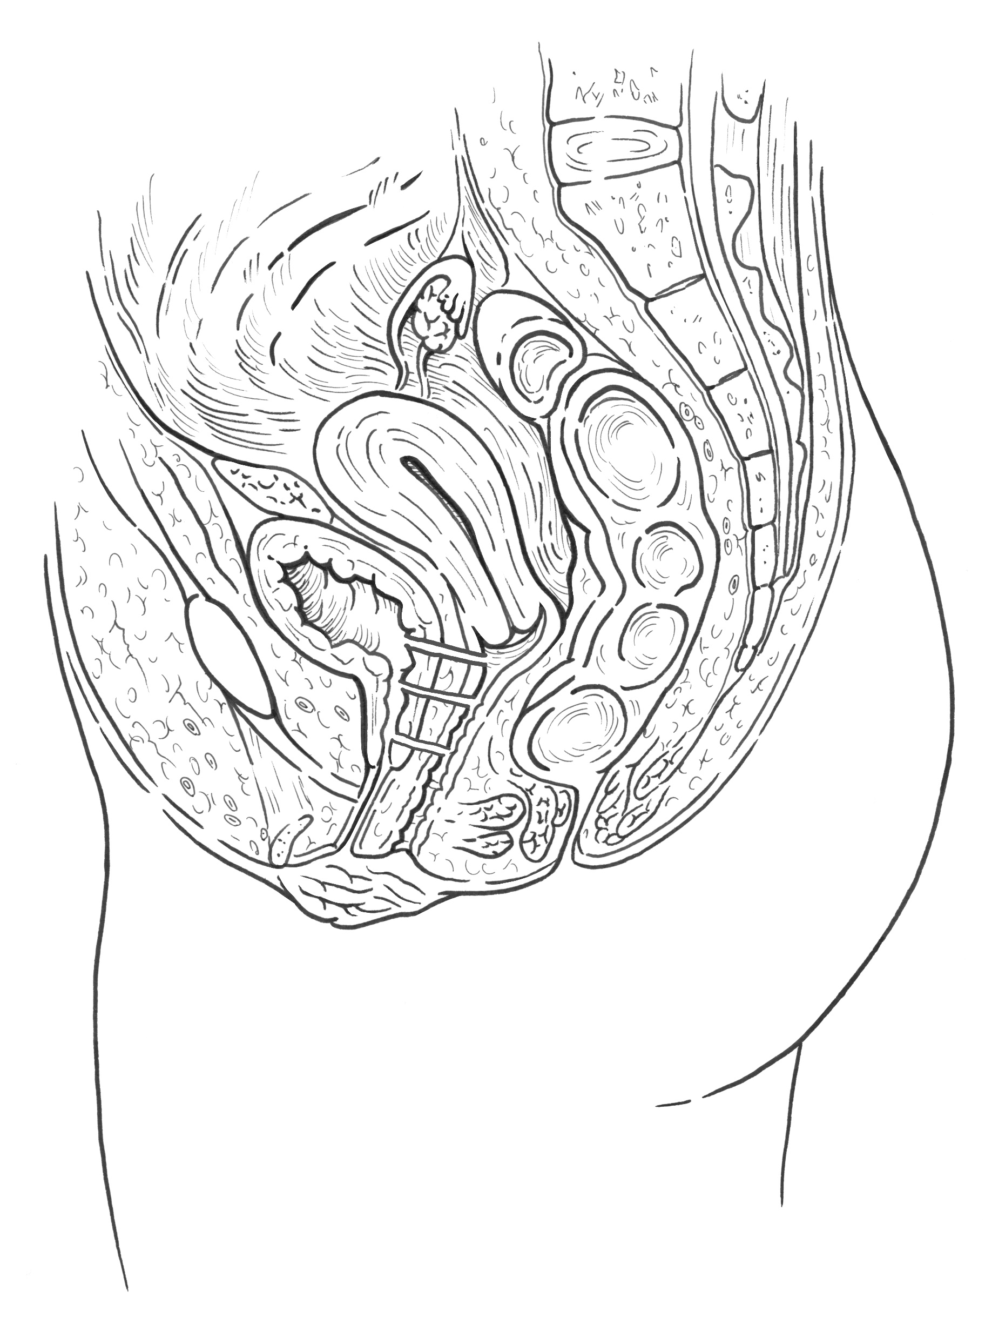
Study design
Pregnant woman - 4 swabs:
vaginal introitus (A)
midvagina (B)
cervix (C)
anus (D)
Newborn:
stool sample after meconium
ear swab
C
B
A
D
Notes:
DNA extractions from all samples were sent for 16S V4 amplicon metagenomic sequencing (Illumina) followed by bioinformatics analyses (DADA2) and contribution estimates of the proportions of different maternal sources to a sample of a neonatal sink was obtained with sourcetracker2 by dyad pair.

Slide 4
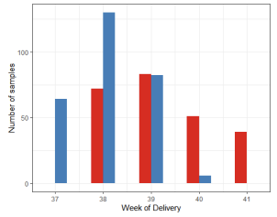
Study design
Mother's Clinical Characteristics | T1D group (n=50) | Control group (n=42) | P-value
Age, mean ± SD | 30.5 ± 4.1 | 32.4 ± 3.7 | 0.01069
Delivery mode
Caesarian | 33 (66%) | 20 (47.5%) | 0.138
Vaginal | 12 (24%) | 17 (40.5%) | 0.1609
Vacuum-assisted vaginal delivery | 5 (10%) | 5 (12%) | 0.7825
Prior C-sections
once | 7 (14%) | 5 (12%) | 0.7816
twice | 1 (2%) | 2 (5%) | 0.4649
none | 42 (84%) | 35 (83%) | 0.9722
Gestation (weeks), mean ± SD | 38.1 ± 0.7 | 39.2 ± 1.0 | <0.0001
Parity
Primiparity | 28 (56%) | 14 (33.5%) | 0.109
Multiparity | 22 (44%) | 27 (64.5%) | 0.1842
NA | 0 (0%) | 1 (2%) | 0.2752
Miscarriages
yes | 7 (14%) | 8 (19%) | 0.5503
no | 41 (82%) | 33 (79%) | 0.8551
NA | 2 (4%) | 1 (2%) | 0.6684
Pre-pregnancy BMI, mean ± SD | 23.19 ± 2.95 | 22.46 ± 2.56 | 0.4227
Pre-pregnancy BMI
Underweight | 1 (2%) | 1 (2%) | 0.9018
Normal | 35 (70%) | 33 (79%) | 0.6338
Overweight | 13 (26%) | 7 (17%) | 0.3389
Obese | 1 (2%) | 0 (0%) | 0.3594
NA | 0 (0%) | 1 (2%) | 0.2752
Before-delivery BMI, mean ± SD | 28.12 ± 3.75 | 27.46 ± 2.97 | 0.6493
Weight gain (kg), mean ± SD | 13.61 ± 5.34 | 14.00 ± 3.79 | 0.7266
Mother's Clinical Characteristics | T1D group (n=50) | Control group (n=42) | P-value
Weight gain**
Non-excess | 32 (64%) | 26 (62%) | 0.8997
Excess | 18 (38%) | 15 (36%) | 0.9818
NA | 0 (0%) | 1 (2%) | 0.2752
Antibiotics prophylaxy
Yes | 34 (68%) | 20 (47.5%) | 0.2037
no | 16 (32%) | 22 (52.5%) | 0.1297
Hypertension
yes | 3 (6%) | 0 (0%) | 0.1124
no | 47 (94%) | 42 (100%) | 0.7707
Gestational hypertension
yes | 2 (4%) | 1 (0.3%) | 0.6684
no | 48 (96%) | 41 (99.7%) | 0.9373
Maternal preeclampsia
yes | 2 (4%) | 0 (0%) | 0.1949
no | 48 (96%) | 42 (100%) | 0.8468
Notes:
Detailed clinical characteristics of the women are presented in Table_ 1. There were differences in the gestation (weeks) between women with T1D (38.1 ± 0.7) and unaffected women (39.2 ± 1.0) (P<0.0001) (Figure S1A). There was no statistically significant difference in terms of delivery mode comparing subgroups of Caesarian and vaginal (including the vaginal and vacuum-assisted vaginal) deliveries in the women with T1D [33 (66%) vs. 17 (34%)] and unaffected women [20 (47.5%) vs. 22 (52.5%)]. At the delivery time women with T1D were younger (30 ± 4) comparing to the unaffected women (32 ± 4) (Table 1). BMI before pregnancy, weight gain during pregnancy and BMI before delivery were comparable in the studied groups of women (Table 1). Detailed dietary aspects recorded for the studied women are described elsewhere [Gutaj et al. 2020], while the selected nutritional aspects (percentages of energy from fat, saturated fatty acids, carbohydrates and proteins) are presented in the Table 1. The percentage of energy derived from total protein in the diet of women with T1D was higher compared to the diet of unaffected women (P= 0.029). The percentage of energy derived from carbohydrates in the diet of women with T1D was lower compared to the diet of unaffected women (P= 0.0171) (Table 1).
Glycaemic control was satisfactory in second and third trimesters in the women with T1D, in accordance with the recommendations of the Polish Diabetes Association, in which one of the criteria for good diabetes control during pregnancy is a glycated hemoglobin level ≤ 6.1% (43 mmol/mol) (Figure S1B). There was no substantial difference in the results of diabetes control when comparing the data of the second and third trimesters of pregnancy (P= 0.682).
Tables prepared in accordance with the TEDDY study 2018

Slide 5
Study design
Neonate's Clinical Characteristics | T1D group (n=50) | Control group (n=42) | p-value
Sex
male | 27 (54%) | 24 (57%) | 0.887
female | 23 (46%) | 18 (43%) | 0.7809
Birth weight
SGA | 4 (8%) | 0 (0%) | 0.06454
AGA | 32 (64%) | 39 (93%) | 0.1341
LGA | 14 (28%) | 3 (7%) | 0.01873
Birth weight (kg), mean ± SD | 3552.80 ± 524.26 | 3405.45 ± 395.51 | 0.09471
Feeding methods
breast milk | 7 (14%) | 40 (95%) | <0.00001
formula | 0 (0%) | 2 (5%) | 0.126
mixed | 41 (82%) | 0 (0%) | <0.00001
Control of postnatal glucose homeostasis
yes | 49 (98%) | 0 (0%) | <0.00001
no | 1 (2%) | 42 (100%) | <0.00001
Postnatal glucose level (mg/dl), mean ± SD* | 50.40 ± 19.01 | NA | -
Proceeded samples** | 48 (96%) | 41 (98%) | -
Notes:
Clinical characteristics of the neonates are presented in Table 2. No preterm neonates were involved in the study. 64% of newborns born to the women with T1D and 93% of newborns of the unaffected women were classified as appropriate for gestational age (AGA), 28% and 7%, respectively, were considered large for gestational age (LGA) (P= 0.0102), while newborn small for gestational age (SGA) were born only to the women with T1D (8%) (Table 2; Figure S2A).
In newborns born to women with T1D, 2-5 measurements of blood glucose levels were performed over time (Figure S2B). Generally, no hypoglycemia was observed in the newborns (Figure S2C). No correlation was found between the glycated hemoglobin level in women with T1D measured before delivery and the level of glucose in newborns born to these women (Figure S3).
14% and 95% of the newborns were breastfed, respectively, by mothers with T1D and unaffected women. Mixed feeding, including mother's milk and formula milk, was administered to 82% of newborns of mothers with T1D (Table 2).

Slide 6
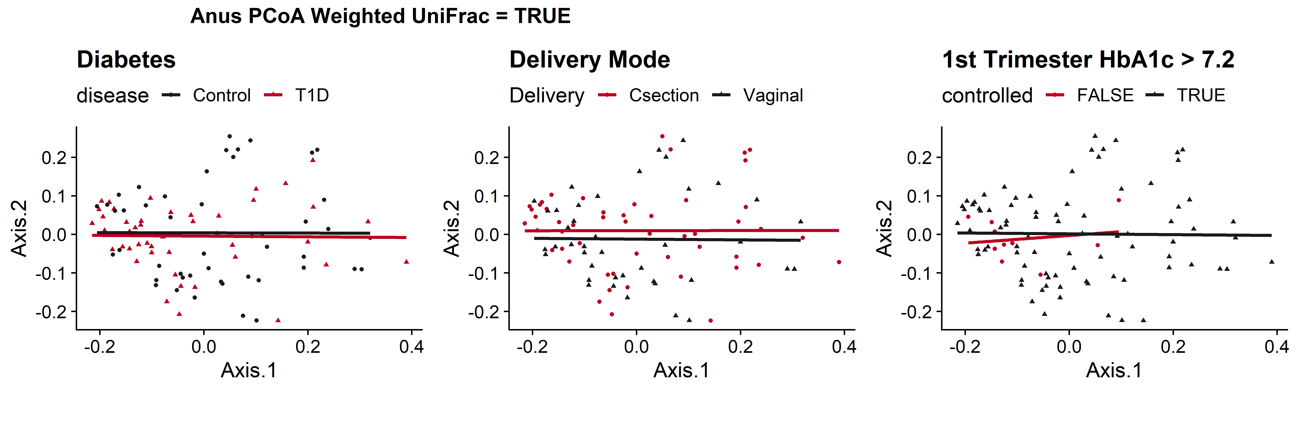
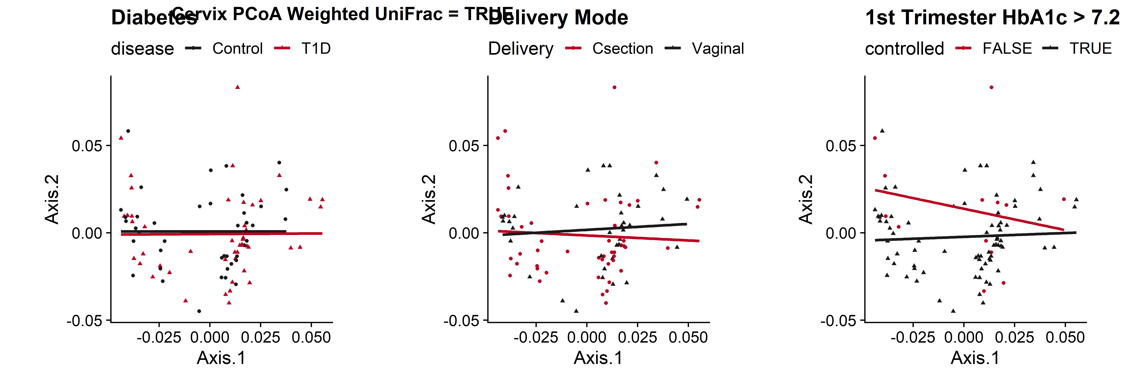
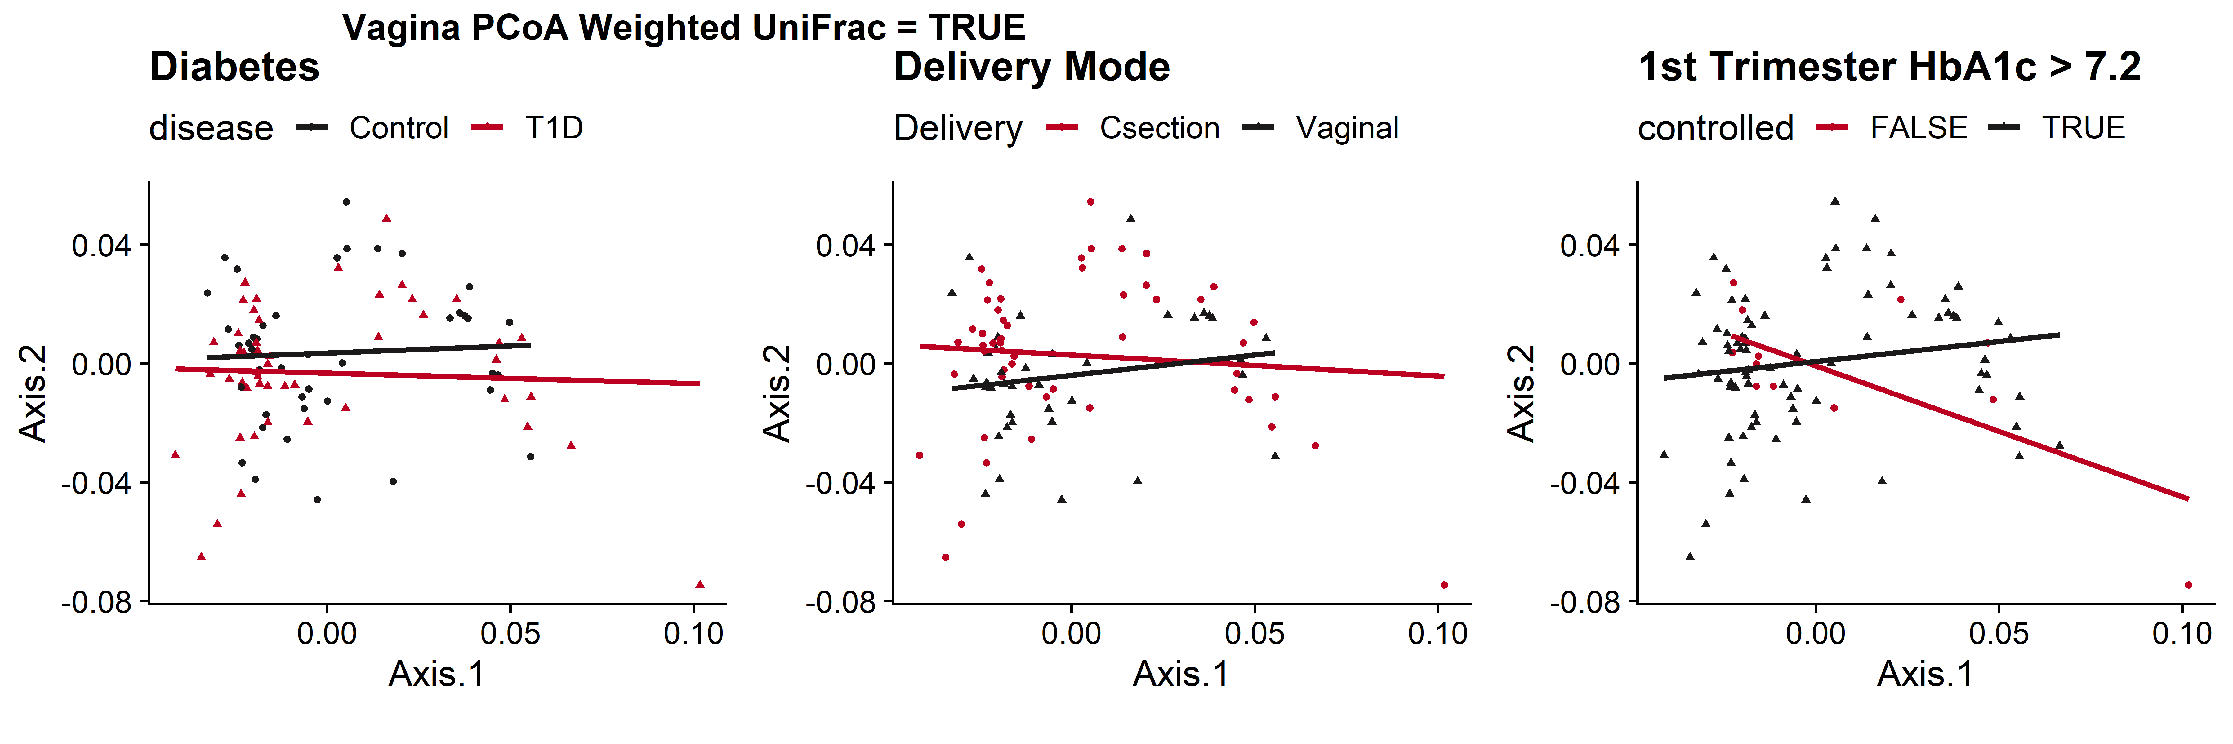
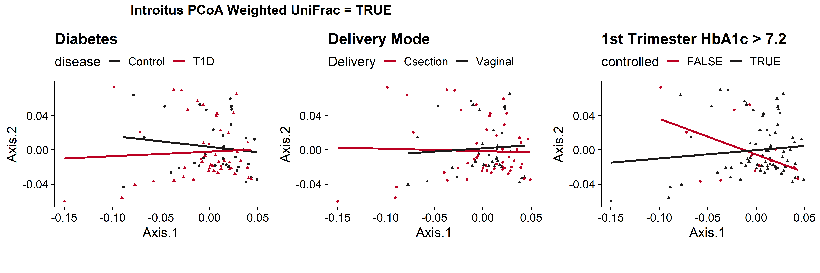
Weighted UniFrac
Rectum
 |  | Weighted UniFrac
Sample Type | Variable | SumOfSqs | R2 | statistic | p.value
Rectum | Type 1 Diabetes | 0.01 | 0.03 | 2.57 | 0.0406 | *
 | Delivery Mode | 0.00 | 0.01 | 0.51 | 0.7685
 | 1st Tri HbA1C | 0.00 | 0.01 | 0.97 | 0.3855
Cervix | Type 1 Diabetes | 0.00 | 0.01 | 0.78 | 0.5825
 | Delivery Mode | 0.00 | 0.01 | 1.03 | 0.3906
 | 1st Tri HbA1C | 0.00 | 0.01 | 0.79 | 0.556
Introitus | Type 1 Diabetes | 0.00 | 0.02 | 1.44 | 0.1824
 | Delivery Mode | 0.00 | 0.02 | 1.67 | 0.112
 | 1st Tri HbA1C | 0.00 | 0.02 | 1.75 | 0.0946
Vagina | Type 1 Diabetes | 0.00 | 0.01 | 1.14 | 0.3226
 | Delivery Mode | 0.00 | 0.02 | 1.73 | 0.1034
 | 1st Tri HbA1C | 0.00 | 0.00 | 0.45 | 0.8508
PERMANOVA = 0.0406 *
Cervix
MidVaginal
Vaginal Introitus
Notes:
Figure X. PCoA plot comparisons of maternal microbiome community composition by disease state(left), delivery mode (center), and maternal 1st trimester hemoglobin A1c values across rectum, cervix, midvaginal, and vaginal introitus sample types (top to bottom). PCoA plots coordinates are based on A) Weighted and B) Unweighted UniFrac dissimilarity indices obtained from VST transformed ASV counts. Trendlines are derived from fitting generalized linear models for each factor and statistical significance annotations are based on adonis2 permutational analysis of variance scores (permutations = 9999)
Table X. adonis2 permutational analysis of variance scores (permutations = 9999) comparisons of maternal and neonatal microbiome community beta diversity by disease state, delivery mode, and maternal 1st trimester hemoglobin A1c values across rectum, cervix, midvaginal, vaginal introitus, stool and ear sample types. Missing 1st trimester hemoglobin A1c values were either imputed using a KNN based model from the remaining metadata values for T1D patients or generated based on a norm distribution derived from average 1st Trimester HbA1C values for nondiabetic mothers (4.96 ± 0.53).

Slide 7
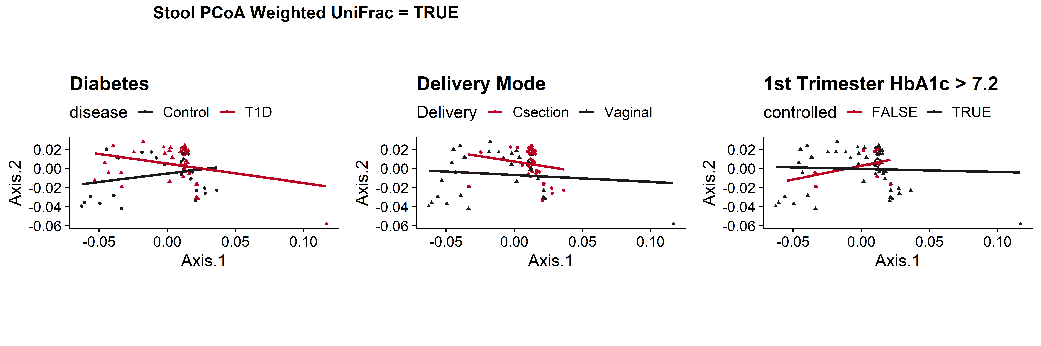
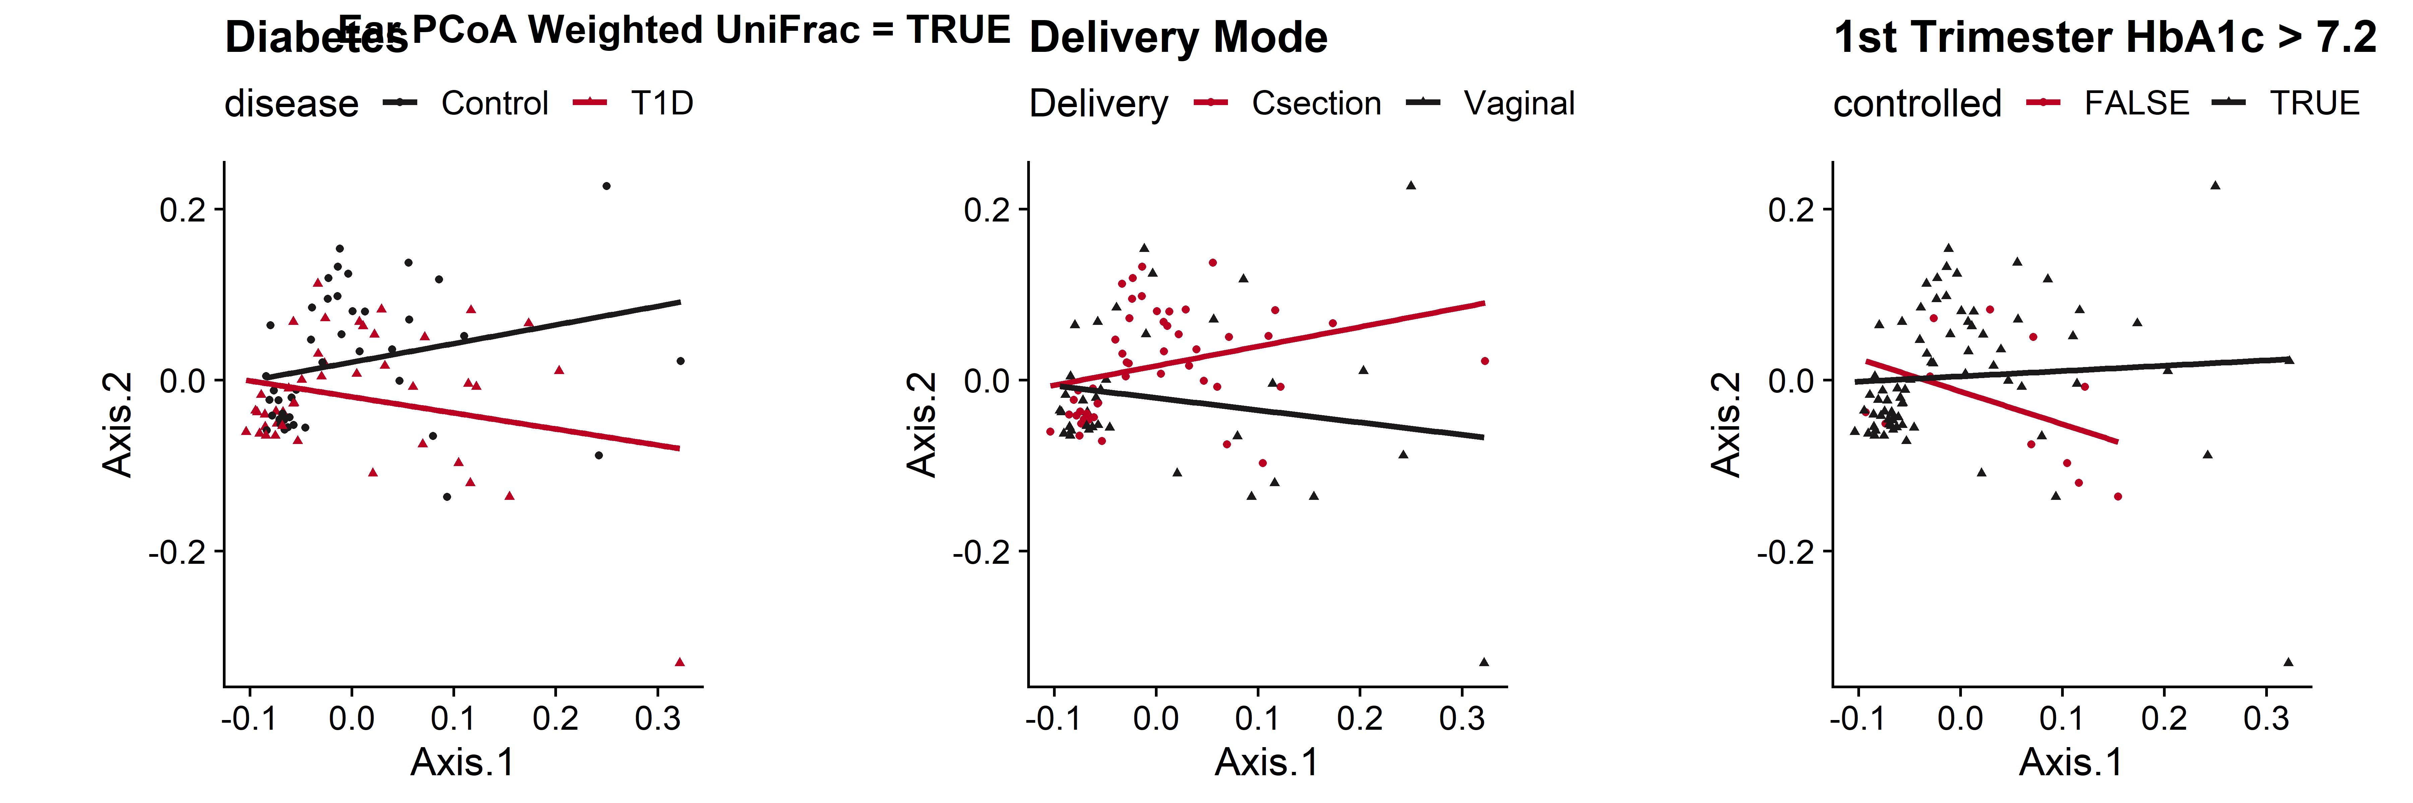
Weighted UniFrac
Stool
PERMANOVA = 0.0544 *
PERMANOVA < 0.0001 ***
Ear
PERMANOVA = 0.0508 *
PERMANOVA = 0.0076 **
 |  |  | Weighted UniFrac
Host | Sample Type | Variable | SumOfSqs | R2 | statistic | p.value
Neonatal | Ear | Type 1 Diabetes | 0.01 | 0.02 | 1.76 | 0.0831
 |  | Delivery Mode | 0.01 | 0.02 | 2.00 | 0.0508 | *
 |  | 1st Tri HbA1C | 0.01 | 0.04 | 3.20 | 0.0076 | **
 | Stool | Type 1 Diabetes | 0.00 | 0.03 | 2.27 | 0.0544 | *
 |  | Delivery Mode | 0.00 | 0.10 | 8.16 | 0.0001 | ***
 |  | 1st Tri HbA1C | 0.00 | 0.01 | 0.63 | 0.6338
Notes:
Figure X. PCoA plot comparisons of neonatal microbiome community composition by disease state(left), delivery mode (center), and maternal 1st trimester hemoglobin A1c values across stool and ear sample types (top to bottom). PCoA plots coordinates are based on A) Weighted and B) Unweighted UniFrac dissimilarity indices obtained from VST transformed ASV counts. Trendlines are derived from fitting generalized linear models for each factor and statistical significance annotations are based on adonis2 permutational analysis of variance scores (permutations = 9999)
Table X. adonis2 permutational analysis of variance scores (permutations = 9999) comparisons of maternal and neonatal microbiome community beta diversity by disease state, delivery mode, and maternal 1st trimester hemoglobin A1c values across rectum, cervix, midvaginal, vaginal introitus, stool and ear sample types. Missing 1st trimester hemoglobin A1c values were either imputed using a KNN based model from the remaining metadata values for T1D patients or generated based on a norm distribution derived from average 1st Trimester HbA1C values for nondiabetic mothers (4.96 ± 0.53).

Slide 8
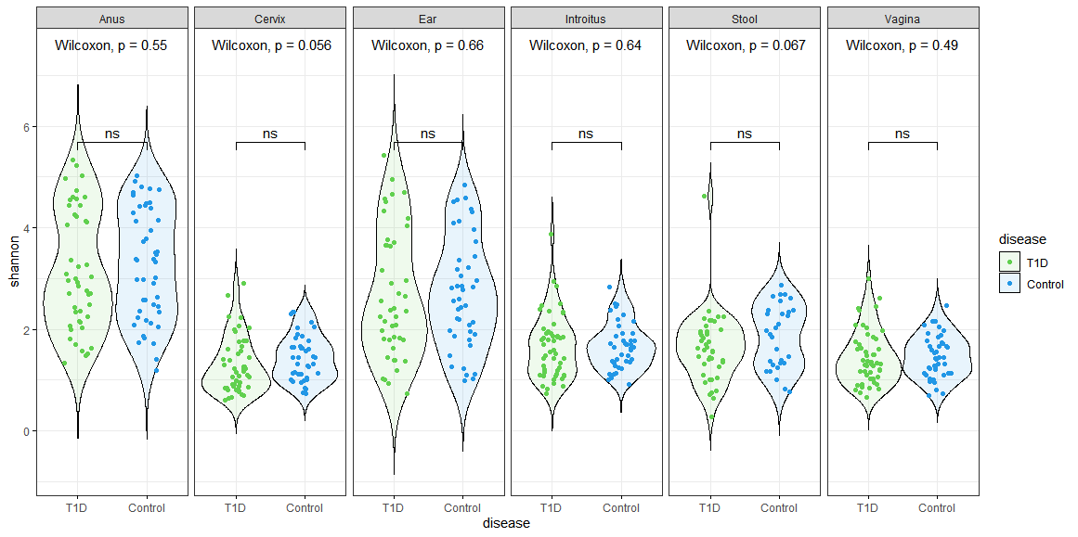
Alpha diversity estimates (Shannon)
library(microbiome)
library(ggpubr)
sam<-data.frame(sample_data(ASV_physeq_core))
alpha<-alpha(x = ASV_physeq_core,index = "shannon")
sam$shannon<-alpha$diversity_shannon
ggviolin(sam, x = "disease", y = "shannon", fill = "disease",
palette =c("#61D04F","#2297E6"),theme_bw()+
add = "boxplot", add.params = list(fill = "white"))+
stat_compare_means(comparisons = my_comparisons, label = "p.signif")+ # Add significance levels
stat_compare_means(label.y = 10) +facet_grid(facets = ~SampleType) # Add global the p-value

Slide 9
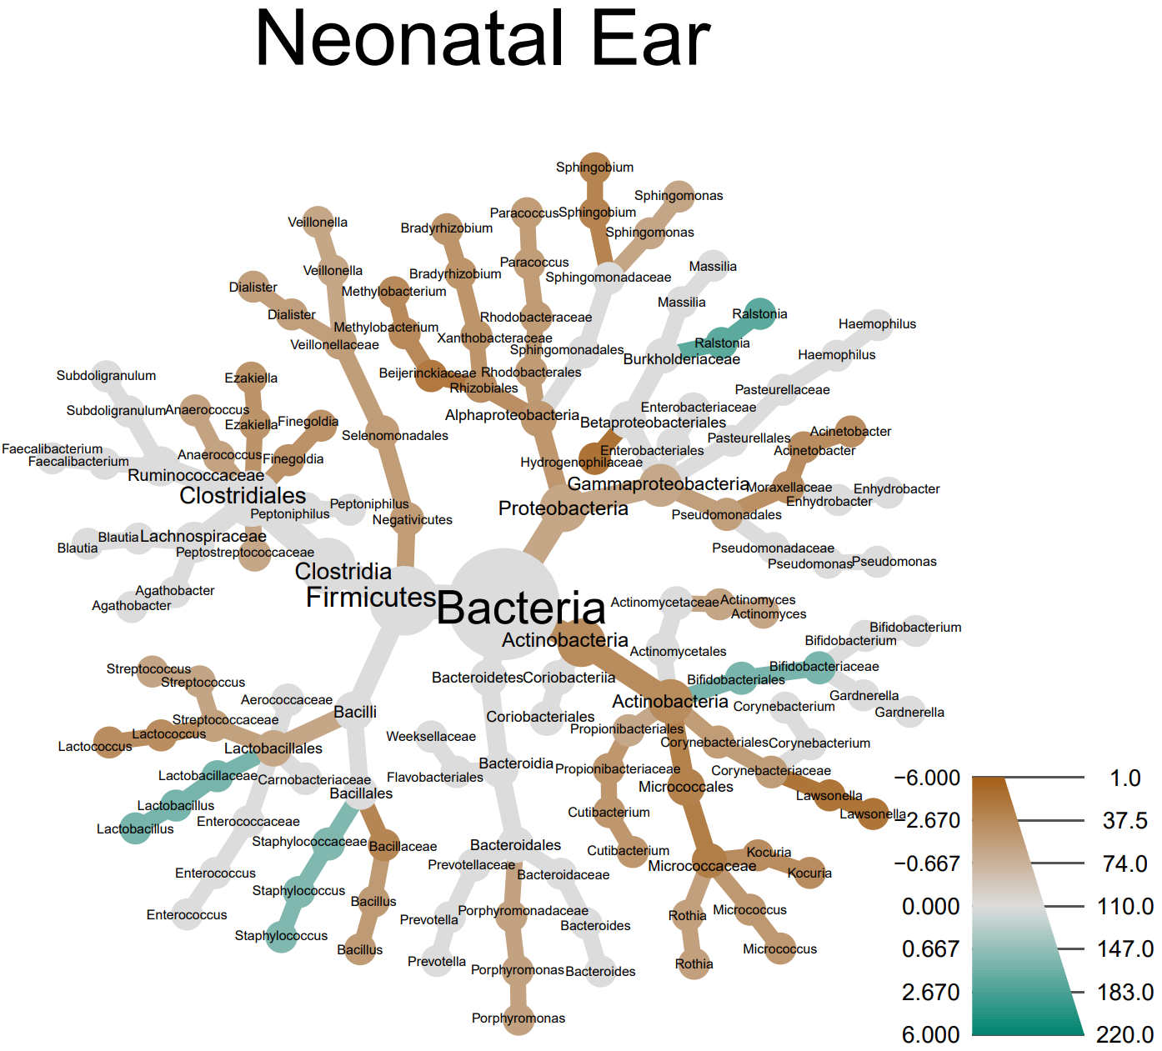
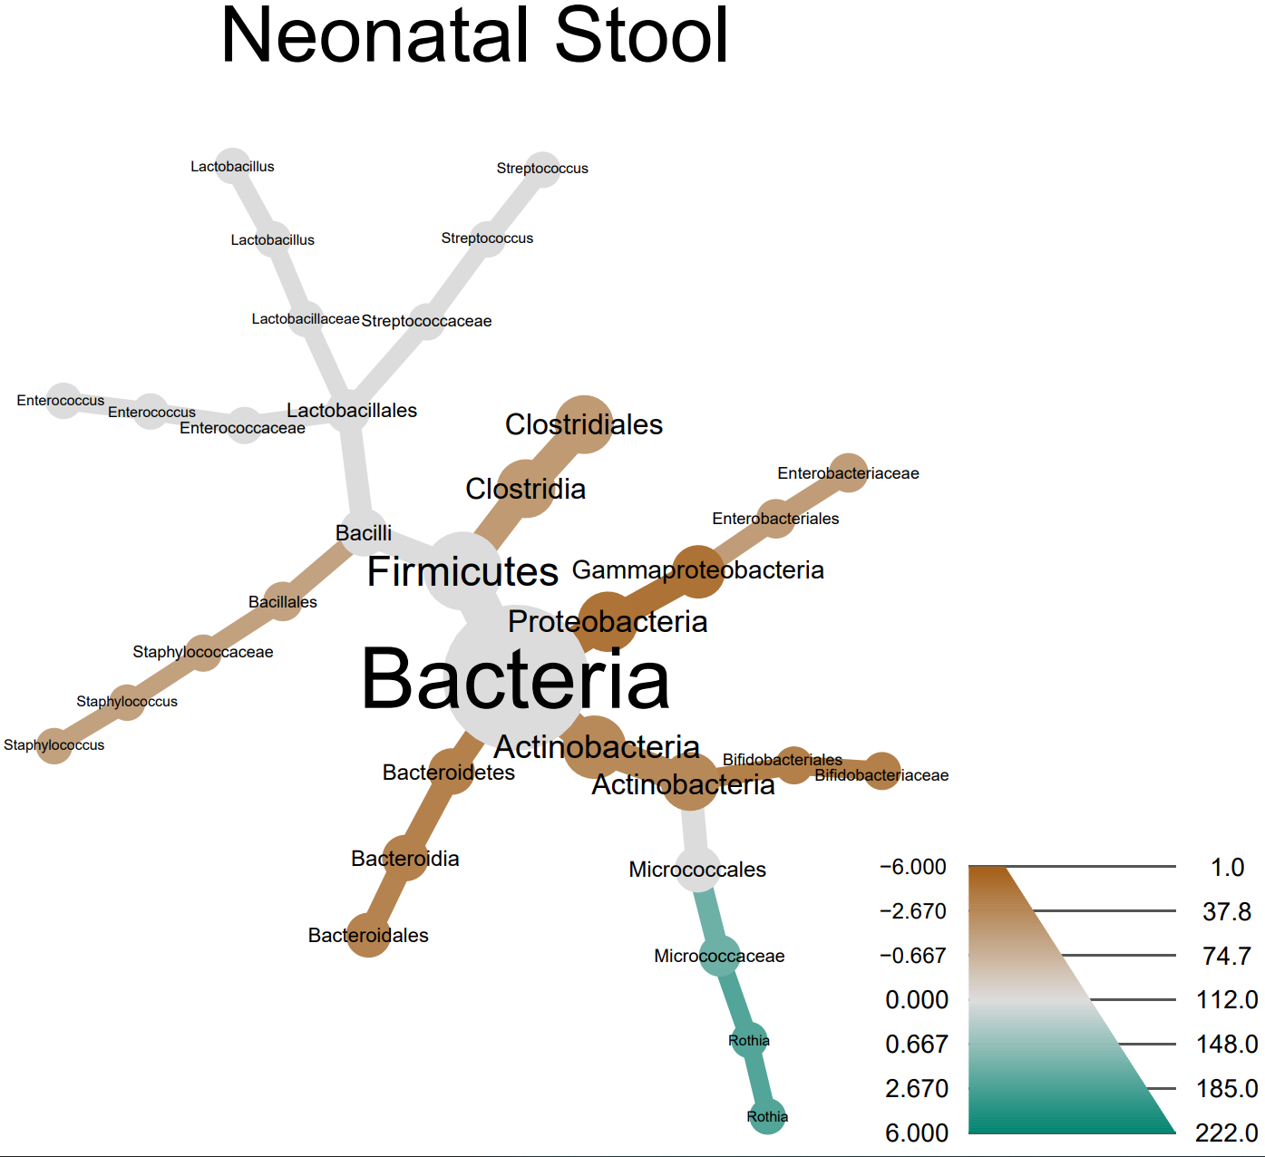
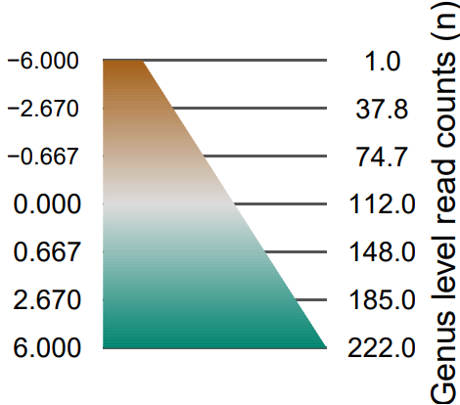
Sample Type | Taxon | Treatment 1 | Treatment 2 | Log₂ median ratio | Median diff | Mean diff | P value
Ear | Actinobacteria | Type 1 Diabetes | Control | -2.533 | -0.052 | -0.079 | 0.016 | **
 | Micrococcaceae | Type 1 Diabetes | Control | -3.497 | -0.014 | -0.080 | 0.003 | ***
 | Micrococcales | Type 1 Diabetes | Control | -3.229 | -0.015 | -0.075 | 0.006 | ***
 | Micrococcus | Type 1 Diabetes | Control | -1.835 | -0.001 | -0.030 | 0.041 | *
Stool | Actinobacteria | Type 1 Diabetes | Control | -2.659 | -0.003 | -0.014 | 0.034 | *
 | Escherichia/Shigella | Type 1 Diabetes | Control | -1.596 | 0.000 | -0.057 | 0.009 | ***
Notes:
Figure X. Heat tree comparisons of the log2 median ratios in the neonatal A) Ear and B) Stool microbiome profiles by Type 1 Diabetes disease state. Nodes are sized by the overall number of Observations matching a particular taxa. Nodes / edges colored in green were more prevalent amongst neonates of Type 1 Diabetic mothers, and nodes in Brown represent taxa that were more prevalent amongst neonates with non-diabetic mothers. See supplementary Tables X for a full list of observed differences.

Slide 10
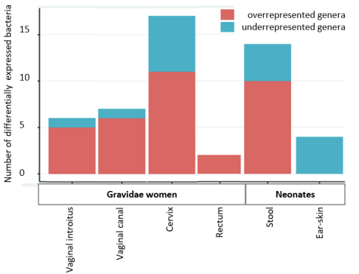
Differentially Expressed Taxa associated with Type 1 Diabetes
Vagina
Genus | baseMean | log2FoldChange | lfcSE | stat | pvalue | padj
Sneathia | 0.91 | 49.75 | 3.14 | 15.87 | 1.07E-56 | 2.44E-54
Intestinibacter | 2.25 | 14.82 | 1.30 | 11.39 | 4.61E-30 | 5.25E-28
Atopobium | 96.63 | 6.82 | 1.01 | 6.78 | 1.18E-11 | 8.97E-10
Megasphaera | 3.66 | 7.80 | 1.38 | 5.64 | 1.70E-08 | 9.70E-07
Streptococcus | 1247.35 | -3.58 | 0.71 | -5.03 | 4.89E-07 | 2.23E-05
Gemella | 7.79 | 7.03 | 1.57 | 4.48 | 7.61E-06 | 2.89E-04
Introitus
Genus | baseMean | log2FoldChange | lfcSE | stat | pvalue | padj
Gemella | 7.79 | 21.38 | 1.59 | 13.40 | 5.79E-41 | 1.32E-38
Citrobacter | 13.12 | 15.31 | 1.50 | 10.23 | 1.42E-24 | 1.62E-22
Terrisporobacter | 2.51 | 14.70 | 1.53 | 9.62 | 6.74E-22 | 5.12E-20
Enhydrobacter | 2.73 | -5.11 | 0.87 | -5.88 | 4.12E-09 | 2.35E-07
Klebsiella | 110.86 | 7.79 | 1.36 | 5.73 | 1.03E-08 | 4.69E-07
Staphylococcus | 11942.17 | 2.43 | 0.58 | 4.20 | 2.64E-05 | 1.00E-03
Cervix
Genus | baseMean | log2FoldChange | lfcSE | stat | pvalue | padj
Enhydrobacter | 2.73 | 18.47 | 0.92 | 20.07 | 1.37E-89 | 2.03E-87
Parabacteroides | 10.17 | 16.91 | 0.98 | 17.23 | 1.60E-66 | 1.18E-64
Collinsella | 5.82 | -15.19 | 1.05 | -14.45 | 2.38E-47 | 1.17E-45
Intestinibacter | 2.25 | 17.92 | 1.31 | 13.63 | 2.84E-42 | 1.05E-40
Sneathia | 0.91 | 42.95 | 3.19 | 13.48 | 1.99E-41 | 5.88E-40
Fusicatenibacter | 4.22 | 14.24 | 1.12 | 12.73 | 4.20E-37 | 1.04E-35
Terrisporobacter | 2.51 | 14.20 | 1.53 | 9.29 | 1.58E-20 | 3.34E-19
Bacteroides | 325.93 | 6.34 | 0.84 | 7.58 | 3.47E-14 | 6.42E-13
Jonquetella | 1.87 | 15.35 | 2.04 | 7.54 | 4.70E-14 | 7.74E-13
Atopobium | 96.63 | 6.62 | 1.02 | 6.49 | 8.72E-11 | 1.29E-09
Bifidobacterium | 521.81 | -5.86 | 0.97 | -6.04 | 1.49E-09 | 2.01E-08
Anaerococcus | 218.60 | -3.20 | 0.63 | -5.08 | 3.75E-07 | 4.62E-06
Gemella | 7.79 | 7.91 | 1.59 | 4.98 | 6.31E-07 | 7.18E-06
Enterococcus | 11413.43 | -2.77 | 0.69 | -4.03 | 5.48E-05 | 5.79E-04
Escherichia/Shigella | 9056.50 | 2.79 | 0.73 | 3.82 | 1.33E-04 | 1.32E-03
Staphylococcus | 11942.17 | -2.09 | 0.58 | -3.60 | 3.18E-04 | 2.94E-03
Fusobacterium | 8.18 | -3.91 | 1.20 | -3.25 | 1.14E-03 | 9.94E-03
Anus
Genus | baseMean | log2FoldChange | lfcSE | stat | pvalue | padj
Staphylococcus | 11942.17 | 3.13 | 0.57 | 5.51 | 3.69E-08 | 8.41E-06
Sneathia | 0.91 | 13.86 | 3.13 | 4.42 | 9.81E-06 | 0.001118
Neonatal Stool
Genus | baseMean | log2FoldChange | lfcSE | stat | pvalue | padj
Fusicatenibacter | 4.22 | 26.44 | 1.23 | 21.47 | 2.68E-102 | 3.03E-100
Fusobacterium | 8.18 | 20.09 | 1.35 | 14.85 | 7.10E-50 | 4.01E-48
Megasphaera | 3.66 | 15.61 | 1.62 | 9.63 | 5.93E-22 | 2.23E-20
Anaeroglobus | 2.73 | 19.46 | 2.23 | 8.72 | 2.88E-18 | 8.13E-17
Pseudomonas | 5.24 | 7.51 | 0.93 | 8.09 | 5.95E-16 | 1.34E-14
Collinsella | 5.82 | -8.77 | 1.13 | -7.77 | 8.16E-15 | 1.54E-13
Romboutsia | 2.19 | 6.40 | 1.20 | 5.33 | 1.01E-07 | 1.63E-06
Peptoniphilus | 132.75 | 3.42 | 0.75 | 4.58 | 4.56E-06 | 6.45E-05
Terrisporobacter | 2.51 | -7.66 | 1.69 | -4.53 | 5.80E-06 | 7.28E-05
Sutterella | 3.18 | -5.19 | 1.20 | -4.34 | 1.45E-05 | 1.64E-04
Dialister | 33.95 | 3.50 | 0.96 | 3.65 | 2.58E-04 | 2.65E-03
Bacteroides | 325.93 | -3.03 | 0.88 | -3.46 | 5.34E-04 | 5.03E-03
Actinomyces | 7.45 | 2.88 | 0.85 | 3.40 | 6.79E-04 | 5.90E-03
Lachnoclostridium | 1.62 | 3.84 | 1.19 | 3.24 | 1.21E-03 | 9.78E-03
Neonatal Ear
Genus | baseMean | log2FoldChange | lfcSE | stat | pvalue | padj
Rothia | 104.70 | -7.75 | 0.94 | -8.21 | 2.18E-16 | 4.96E-14
Micrococcus | 34.25 | -3.71 | 0.74 | -5.02 | 5.24E-07 | 5.98E-05
Escherichia/Shigella | 9056.50 | -3.05 | 0.74 | -4.10 | 4.08E-05 | 3.10E-03
Kocuria | 7.55 | -3.29 | 0.82 | -4.00 | 6.35E-05 | 3.62E-03
Notes:
Figure 2. Number of differentially expressed microbiota (genera) associated with T1D in the assessed sample types (swabs taken from vaginal introitus, vaginal canal in the middle, ectocervix, and rectum as well as neonatal stool samples, and ear-skin swabs). Among the 17 genera, 11 were overrepresented and 6 were underrepresented in the cervix of the women with T1D. In the vaginal introitus and vaginal canal in the middle numbers of differentially expressed bacteria associated with T1D were similar. Two genera, Staphylococcus and Sneathia were found as overrepresented in the samples taken from rectum of the women with T1D. Comparing the four types of material samples taken from women, Snetahia, Gemella, and Staphylococcus as well as Intestinibacter, Atopobium, Terrisporobacter, and Enhydrobacter were identified as differentially expressed genera associated with T1D in more than one sampling site, respectively in 3 and 2 material types derived from the women with T1D. No overrepresented bacteria associated with T1D in the ear-skin swabs were identified. Rothia, Micrococcus, Escherichia/Shigella, and Kocuria were underrepresented in the ear-skin swabs derived from the neonates of the women with T1D, comparing to the ear-skin swabs derived from the neonates of the control women. Fusicatenibacter, Fusobacterium, Megasphaera, Anaeroglobus, Pseudomonas, Romboutsia, Peptoniphilus, Dialister, Actinomyces, and Lachnoclostridium were overrepresented in the stool samples derived from the neonates of the women with T1D, while Collinsella, Terrisporobacter, Sutterella, and Bacteroides were underrepresented in these samples
Differentially expressed bacteria associated with T1D were revealed in the three assessed vaginal sampling sites with the majority of these bacteria recognized in the cervix (Table 3), namely Enhydrobacter, Parabacteroides, Collinsella, Intestinibacter, Sneathia, Fusicatenibacter, Terrisporobacter, Bacteroides, Jonquetella, Atopobium, Bifidobacterium, Anaerococcus, Gemella, Enterococcus, Escherichia/Shigella, Staphylococcus, and Fusobacterium genera. Among these 17 genera, 11 were overrepresented and 6 were underrepresented in the cervix of the women with T1D (Table 3, Figure 2). In the vaginal introitus and midvaginal canal numbers of differentially expressed bacteria associated with T1D were similar. Two genera, Staphylococcus and Sneathia were found as overrepresented in the samples taken from rectum of the women with T1D.
Comparing the four types of material samples taken from women, Snetahia , Gemella , and Staphylococcus as well as Intestinibacter , Atopobium , Terrisporobacter , and Enhydrobacter were identified as differentially expressed genera associated with T1D in more than one sampling site, respectively in 3 and 2 material types derived from the women with T1D (Table 3).
). No overrepresented bacteria associated with T1D in the ear-skin swabs were identified. Rothia, Micrococcus, Escherichia/Shigella, and Kocuria were underrepresented in the ear-skin swabs derived from the neonates of the women with T1D, comparing to the ear-skin swabs derived from the neonates of the control women. Fusicatenibacter, Fusobacterium, Megasphaera, Anaeroglobus, Pseudomonas, Romboutsia, Peptoniphilus, Dialister, Actinomyces, and Lachnoclostridium were overrepresented in the stool samples derived from the neonates of the women with T1D, while Collinsella, Terrisporobacter, Sutterella, and Bacteroides were underrepresented in these samples (Figure 2).

Slide 11
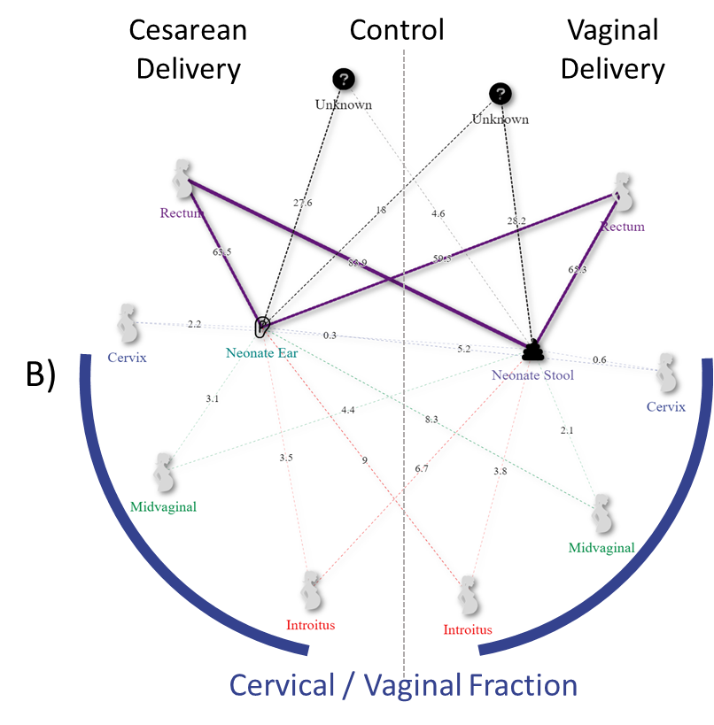
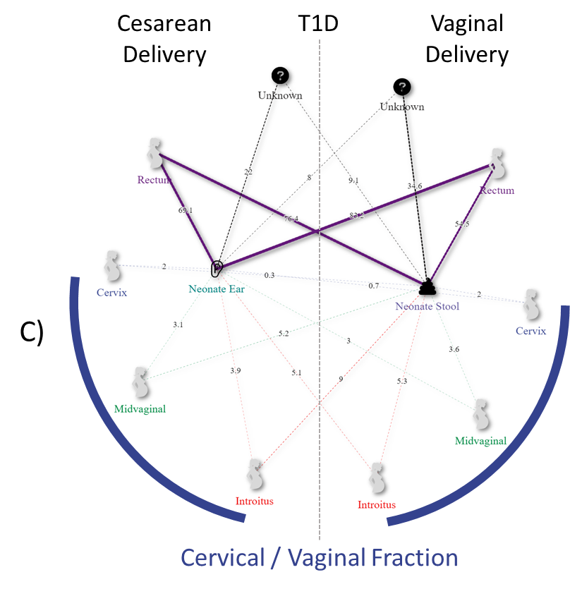
Source tracking the Neonatal Microbiome by Disease and Delivery
 |  |  | Source (mean ± std. error)
Delivery | Sink | Disease | Anus | Cervix | Introitus | Unknown | Vagina
C-section | Ear | Control | 0.635 ± 0.31 | 0.022 ± 0.048 | 0.035 ± 0.043 | 0.276 ± 0.285 | 0.031 ± 0.051
 |  | T1D | 0.691 ± 0.28 | 0.02 ± 0.03 | 0.039 ± 0.038 | 0.22 ± 0.25 | 0.031 ± 0.032
 | Stool | Control | 0.839 ± 0.104 | 0.003 ± 0.003 | 0.067 ± 0.033 | 0.046 ± 0.111 | 0.044 ± 0.024
 |  | T1D | 0.764 ± 0.252 | 0.003 ± 0.005 | 0.09 ± 0.091 | 0.091 ± 0.209 | 0.052 ± 0.069
Vaginal | Ear | Control | 0.595 ± 0.311 | 0.052 ± 0.092 | 0.09 ± 0.096 | 0.18 ± 0.247 | 0.083 ± 0.105
 |  | T1D | 0.832 ± 0.198 | 0.007 ± 0.011 | 0.051 ± 0.076 | 0.08 ± 0.174 | 0.03 ± 0.047
 | Stool | Control | 0.653 ± 0.317 | 0.006 ± 0.006 | 0.038 ± 0.024 | 0.282 ± 0.331 | 0.021 ± 0.014
 |  | T1D | 0.545 ± 0.336 | 0.02 ± 0.062 | 0.053 ± 0.053 | 0.346 ± 0.343 | 0.036 ± 0.042
Notes:
Figure X. A) Control and B) Type one diabetes network of Sourcetracker2 derived maternal contributions (outside nodes) to neonatal microbiomes (inside nodes) by disease states and delivery modes Cesarean (left) and Vaginal (right). Results show statistically significant increases in maternal source Anus contributions to the ear microbiome when comparing vaginally delivered neonatal ear microbiomes from type 1 diabetic mothers to the control.
Overall, results revealed that there was not a significant impact on the maternal microbiome’s ability to influence the neonatal microbiome. When stratified by source type and delivery method, we observed a significant effect of disease on maternal contribution from the maternal source microbiomes to the neonatal ear microbiome amongst vaginally delivery patients, but all other source contributions comparisons were deemed not significant, or a product of delivery method and not an effect of the impact of disease
Transmission of T1D specific bacteria from woman to neonate (Mother-to-neonate T1D specific bacteria transition)
Analyzing the microbiota composition of maternal-neonatal dyads, 41 genera were identified as common to women and their neonates, presented as numbers of the dyads in the Figure 3.
Seven of the differentially expressed genera associated with T1D found in the vaginal and rectum samples were also revealed to be specific for the ear-skin swabs or stool samples in the offspring of the women with T1D. Fusicatenibacter, Fusobacterium, Megasphaera, Collinsella, Terrisporobacter, and Bacteroides as well as Escherichia/Shigella were indicated as differentially expressed genera in the neonatal stool samples and the ear-skin swabs of the neonates born to women with T1D, respectively.
Differences in microbiota composition between neonates born by Cesarean section and vaginally delivered
The influence of the delivery mode on neonatal microbiota composition was found in the neonates regardless of the mother’ disease status (P=0.0008; Figure 4, Table 4A).
Microbiota composition could not be distinguished among Cesarean and vaginally born offspring of the T1D mothers (P>0.05; Table 4A).

Slide 12
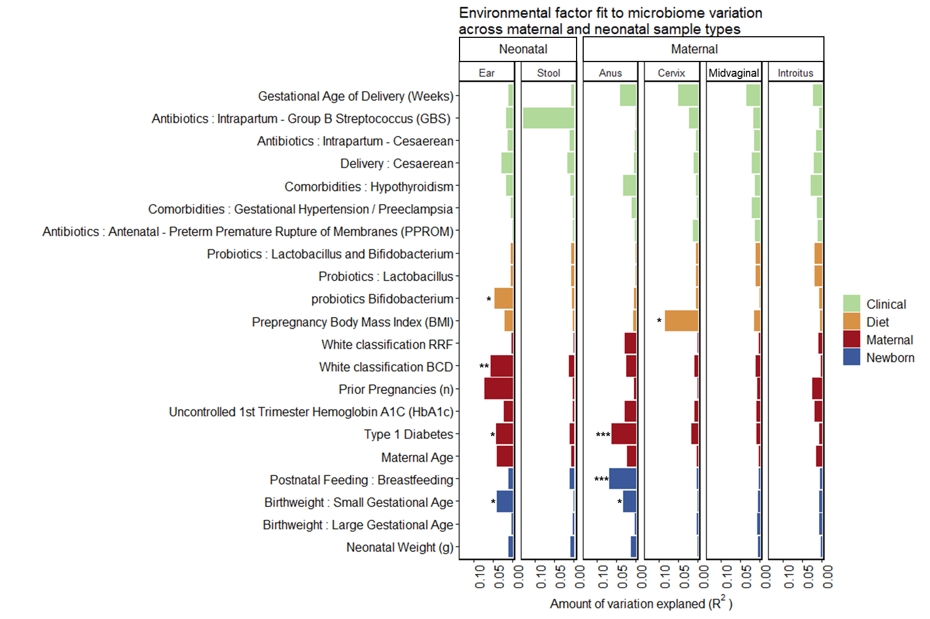
Microbiome variation explained by environmental factors across neonatal and maternal sample types.
Notes:
Comparison of the amount of microbiome variation explained by environmental factors across neonatal and maternal sample types. The goodness of fit statistic squared correlation coefficient (R²) used in determining the percent microbiome variation explained by a feature is calculated via multiple regression of environmental vectors and factors as dependent variables against variable stabilizing transformed (VST) Euclidean sample distances ordinations axes as explanatory variables. Comparisons of significance of the correlation coefficients was tested via Monte Carlo permutational testing (n = 999).
Supplementary Table X. Overview table of the amount of microbiome variation explained by environmental factors across neonatal and maternal sample types. The goodness of fit statistic squared correlation coefficient (R²) used in determining the percent microbiome variation explained by a feature is calculated via multiple regression of environmental vectors and factors as dependent variables against variable stabilizing transformed (VST) Euclidean sample distances ordinations axes as explanatory variables. Comparisons of significance of the correlation coefficients was tested via Monte Carlo permutational testing (n = 999).

Slide 13
Conclusions
There were significant differences in community assemblage associated with :
Type 1 diabetes
Maternal rectum
Neonatal Stool
Delivery mode
Neonatal Ear and Stool
Uncontrolled 1st Trimester HbA1c
Neonatal Ear
We observed taxonomic differences discriminant of Type 1 Diabetes in both the maternal and neonatal samples
Source tracker maternal source contributions to neonatal sinks
Environmental fitting analysis
Maternal
Disease state
Postnatal feeding : breastfeeding
BMI
Neonate
Disease and disease severity (White classification)
Probiotic use of Bifidobacterium
Notes:
Overall, the vast majority (>36%) of the neonate’s microbiota comprising its microbiome within 2 days of birth could be attributed to its maternal source (Fig. & Table). When stratified by source type and delivery method, we observed a significant effect of maternal T1D disease but not mode of delivery (Fig & Table). In both control and T1D dyad pairs, the greatest source contributor to the neonatal microbiome was traced to maternal stool source and vaginal vs stool vs cervix were not of significant difference in vaginal vs Cesarean born neonates.
Comparisons of significance of the correlation coefficients was tested via Monte Carlo permutational testing (n = 999).
Conclusion: Although this study is limited with respect subject diversity, these findings by and large suggest that maternal contributions to the neonatal microbiome are the principal sources, and there is variation by virtue of maternal T1D. Given that vaginally delivered & Cesarean born neonates are equally likely to have the majority of their microbiota tracked to maternal stool and vaginal sources, this reinforces the notion that intrauterine factors likely influence the infant microbiome.
In the TEDDY study [Stewart et al. TEDDY study, 2018], breastfeeding was the only covariate that was significantly associated with metabolic potential,
Numerous pathways were differently represented in the shared pathways analysis in maternal-neonatal dyads, while combining neonates’ samples. We noted that main covariate causing clustering was the mother disease status rather than delivery mode. Among those pathways the reaction including branched amino acids degradation (L-leucine degradation I), which have been shown to interfere with insulin signaling by stimulating mTOR [Yoon et al. 2016] were found to be significantly rarer shared between gravidae with T1D and her neonate. Moreover, the glyoxylate cycle was also more commonly shared in T1D maternal-neonatal dyads, while previously the elevated glyoxylate plasma levels were indicated as a biomarker of type 2 diabetes, even as much as 3 years prior to diagnosis of diabetes [Nikiforova et al. 2014], and proposed to has been a contributor of insulin resistance [Song et al. 2000]. Also, we found enriched sharing of superpathway of L-arginine, putrescine, and 4-aminobutanoate degradation in T1D mother-neonate pairs, which is in line with the TEDDY study [Vatanen et al. 2018].

Slide 14
Clinicians involved:
Prof. Ewa Wender-Ozegowska, MD, PhD, and Dr. Pawel Gutaj, MD, PhD, gynaecologists
Prof. Tomasz Szczapa, MD, PhD, neonatologist
Poznan University of Medical Sciences, Poznan, Poland
Researchers (Microbiome study only):
Kasia Jaskiewicz, MSc, PhD Student
Institute of Human Genetics, PAS, Poznan, Poland
Dorota Kaminska, PhD
Poznan University of Medical Sciences, Poznan, Poland
Małgorzata Rydzanicz, PhD
Medical University of Warsaw, Warsaw, Poland

Slide 15
































Acknowledgements
Baylor College of Medicine
Aagaard Lab 2023
Sohini Banerjee, PhD
Enrico Barrozo, PhD
Erin Bolte, MSc
Angela Burgess, MD
Jia Chen, RN MA
Sarah Detlefs, MD MS
Ricardo Ferral Rojas, MD
Alison Goulding, MD MSCR
Min Hu, MD
Gwen Hummel, MSc
Michael Jochum, PhD
Grace Johnson, MD
David Moorshead, BSc
Derek O’Neil, PhD
Ryan Rochat, MD PhD
Alexa Sassin, MD
Maxim Seferovic, PhD
Matthew Shanahan, MD
Cynthia Shope, MSc
Lori Showalter, BSc
Melissa Suter, PhD
Greg Valentine, MD MED
Jorge Zaragoza Zapiain, MD
Maryshe Zietsman, BSc
Texas Children’s
Pathology & Immunology
James Versalovic, MD PhD
Daniel Lacorazza, PhD
Chun Shik Park, BSc
Jim Dunn, PhD
Eumenia Castro, MD PhD
Baylor College of Medicine
Molecular Imaging Core
Fabio Stassi, PhD
Michael Mancini, PhD
Rice University
Department of Computer Science
Todd Treangen, PhD
Division of Maternal-Fetal Medicine
Carey Eppes, MD MPH
Martha Rac, MD
Michael Belfort, MD PhD
Baylor College of Medicine
HGSC & Core Labs
Richard Gibbs, PhD
Lisa White, PhD
Baylor College of Medicine
Molecular Virology & Microbiology
Janet Butel, PhD
Mary Estes, PhD
Kristy Murray, DVM PhD
Rodion Gorkachov, PhD
Joe Petrosino, PhD
Notes:
15
15
15

Slide 16
Supplemental
Jochum, Michael D.

Slide 18
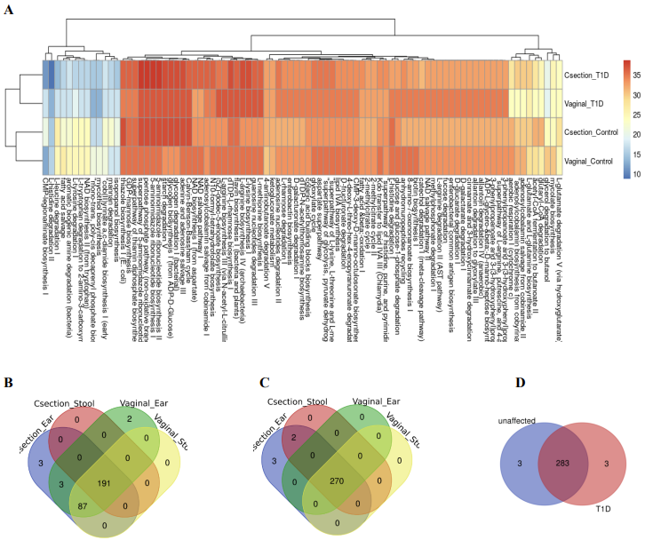
Notes:
Figure 6. Prediction of pathways common to the samples of the maternal-neonatal dyads. A. The top most common predicted to share pathways for combined neonate’s samples, presented as percentage of dyads with presence of particular pathway in maternal vaginal sites and neonatal samples. The results indicate that the major covariate driving the clustering is the maternal disease status rather than the mode of delivery. B-C. Metagenomic pathways found in at least 50% of dyads of control women (B) and women with T1D (C), for separated neonate’s samples, predicted using PICRUSt. Each prediction of a specific metagenomic pathway common to one of the maternal sample types and one of the neonatal sample types was counted in the maternal - neonatal dyads (the ear-skin swab from Csection born neonates, ear-skin swab from Vaginally delivered neonates, stool samples from Csection born neonates, and stool samples from Vaginally delivered samples were assessed separately). The 191 pathways from control mother-neonatal dyads and 270 pathways from mother with T1D-neonatal dyads were shared regardless the delivery mode and neonatal sample type. D. Independently of neonatal sample type, 283 metagenomic pathways shared in the all studied dyads were predicted. Three biosynthesis pathways were predicted as exclusively shared within control mother-neonatal dyads, while three pathways were predicted as exclusively shared within mother with T1D-neonatal dyads.

Slide 19
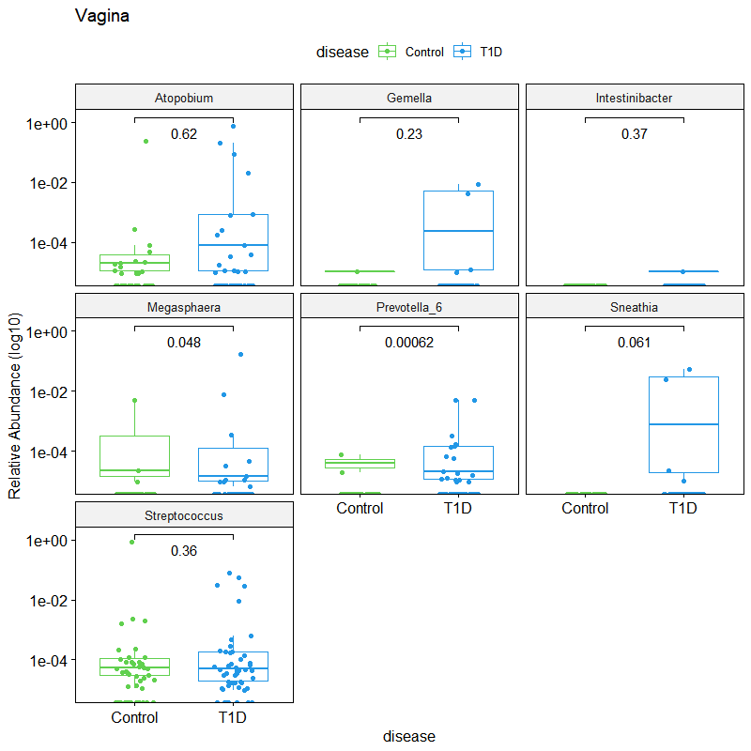
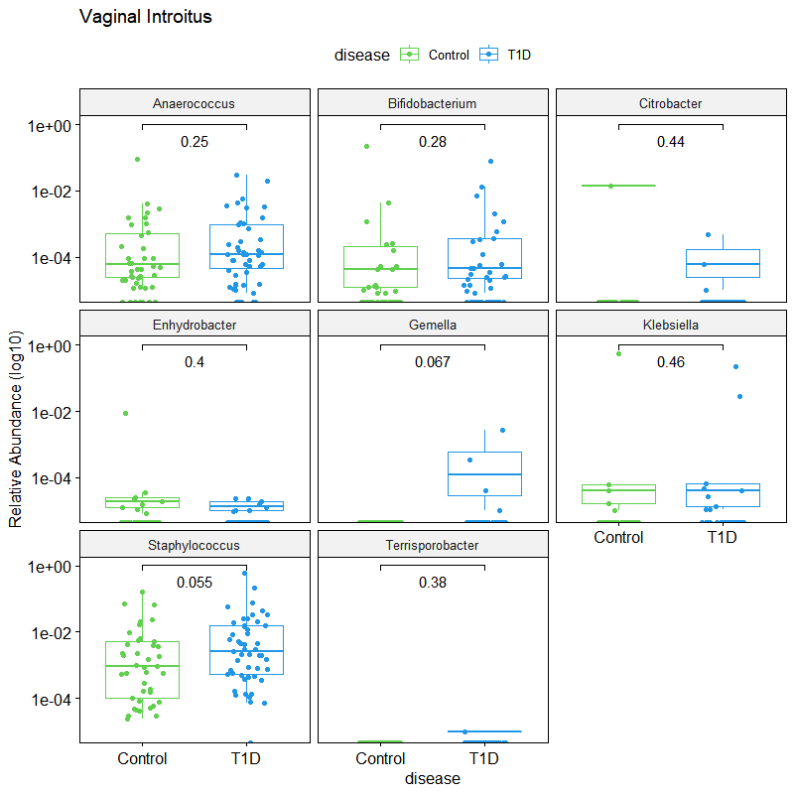
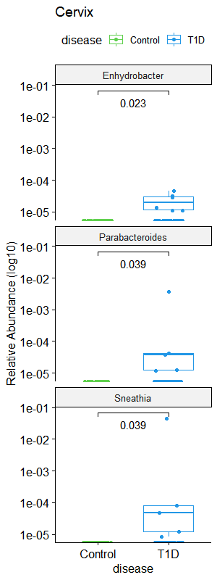
A) Mid-vaginal canal
B) Vaginal Introitus
C) Cervix
Figure X. Wilcox test comparisons of differentially expressed genera associated with Type 1 Diabetes in the A) Vaginal canal, B) Vaginal Introitus, C) Cervix, and D) Anus samples

Slide 20
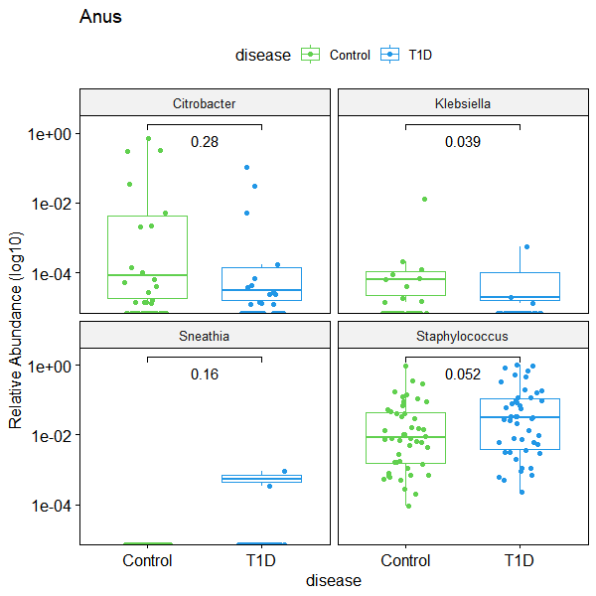
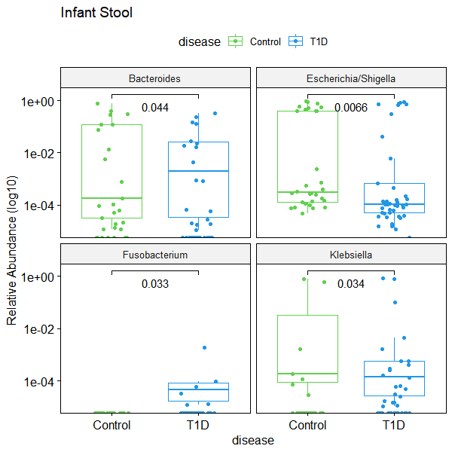
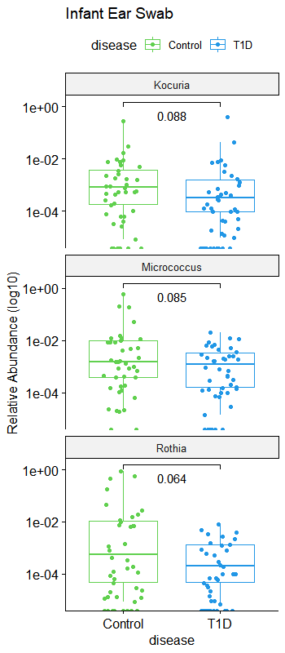
D) Anus
E) Infant Stool
F) Infant Ear swab
Figure X. Wilcox test comparisons of differentially expressed genera associated with Type 1 Diabetes in the
D) Anus, E) Infant stool, and F) infant ear microbiomes.

Slide 21
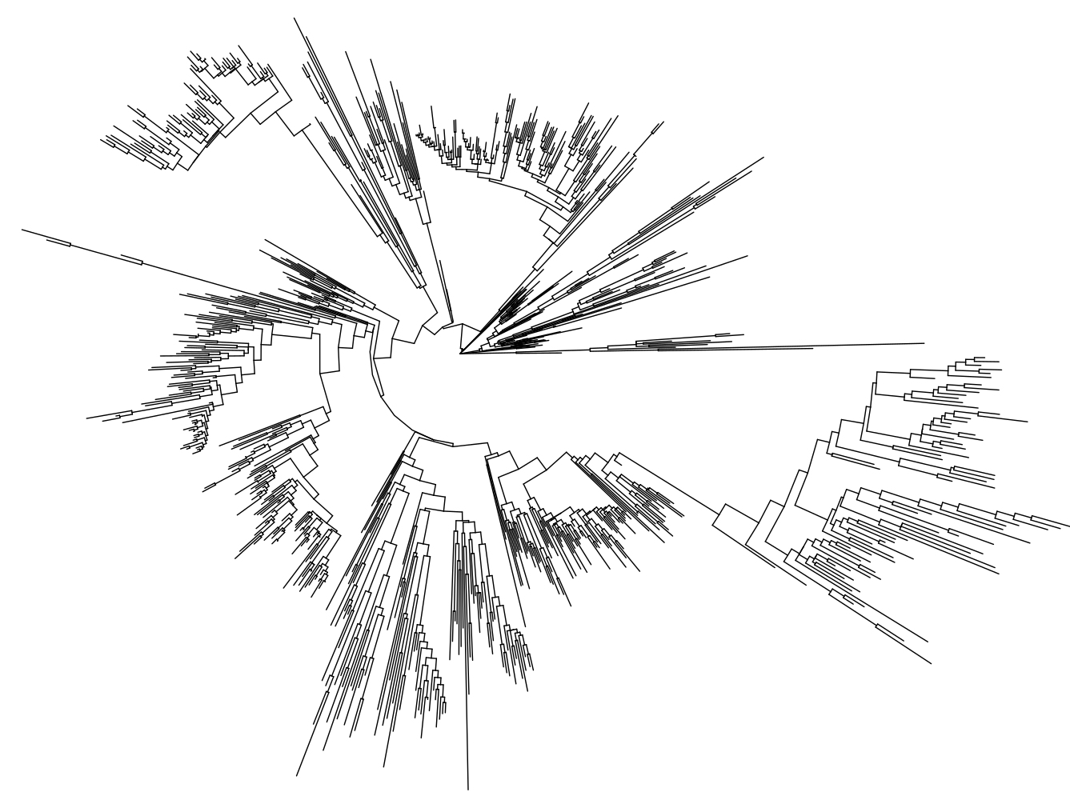
Make a phylogenetic distance tree of the taxa
overview of phylogenetic distances for all samples based on ASV fasta sequence alignment optimal model fit
2683 tips and 2681 internal nodes

Slide 22
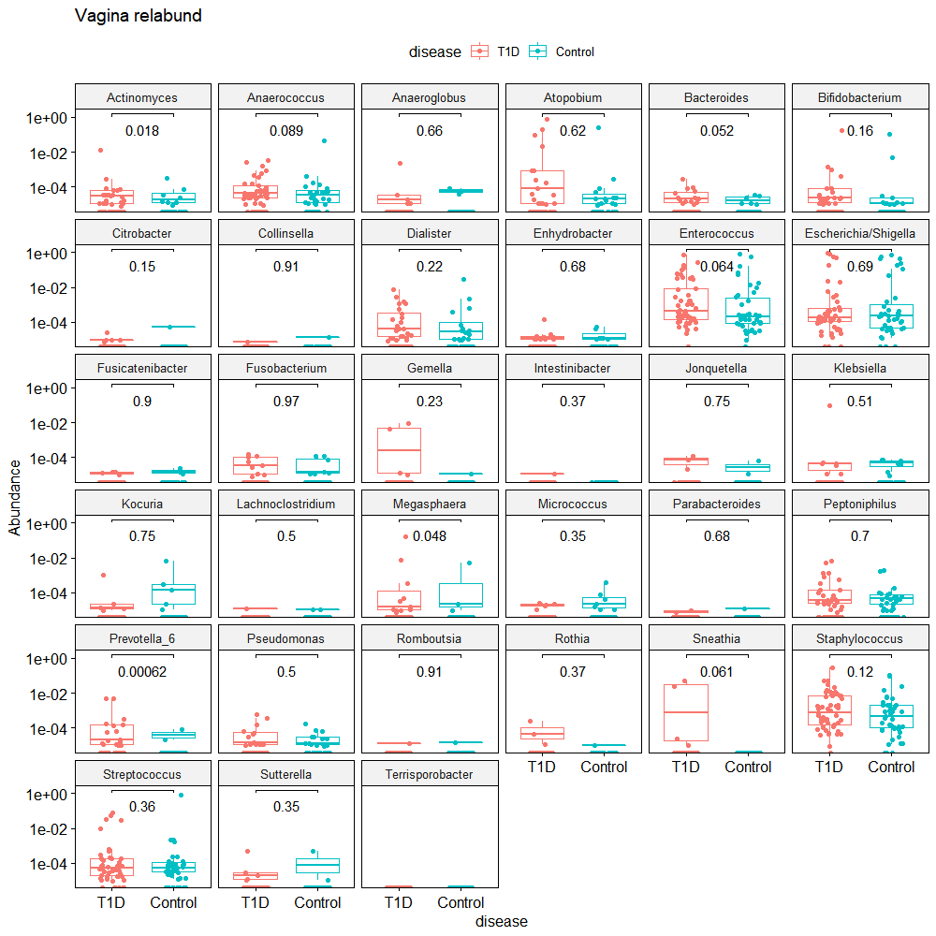
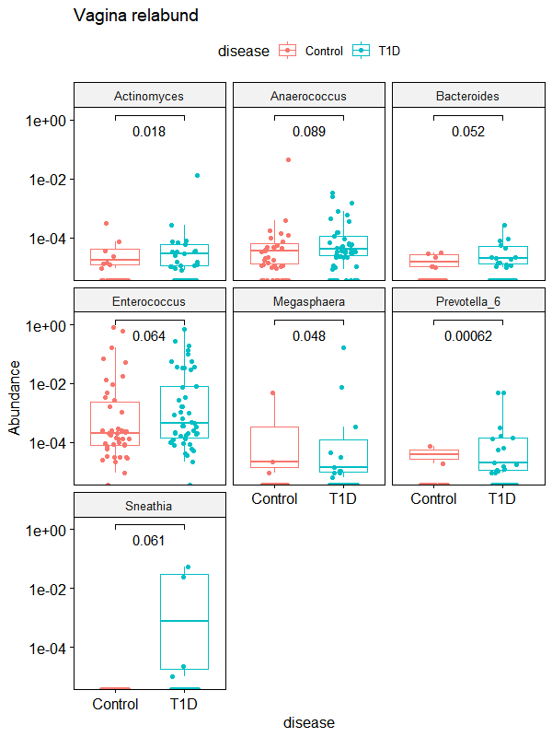

Slide 23
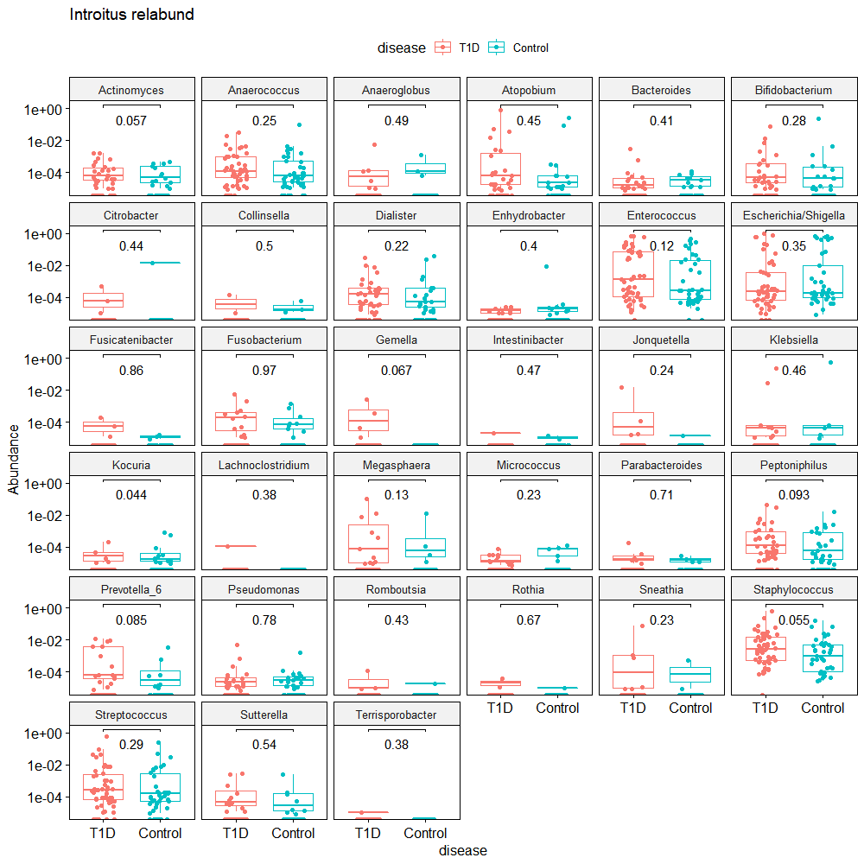
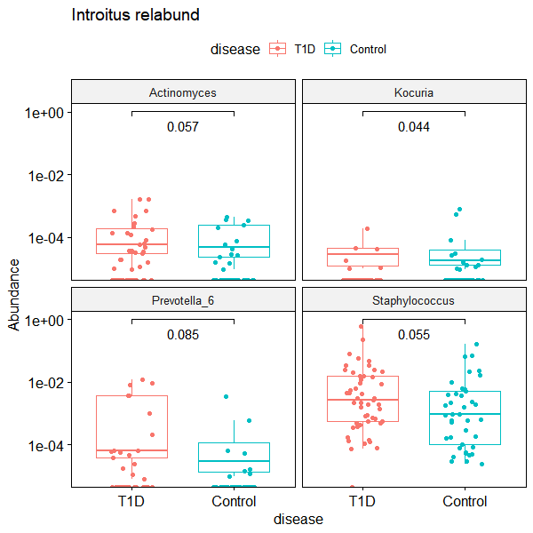

Slide 24
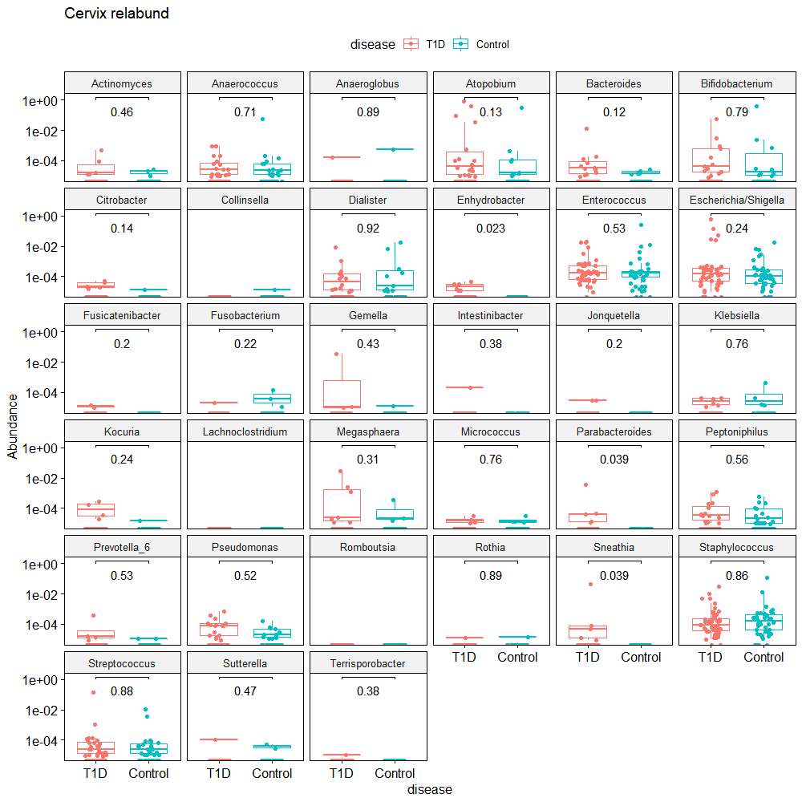
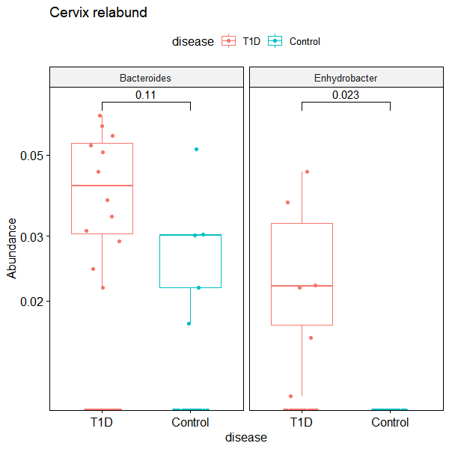

Slide 25
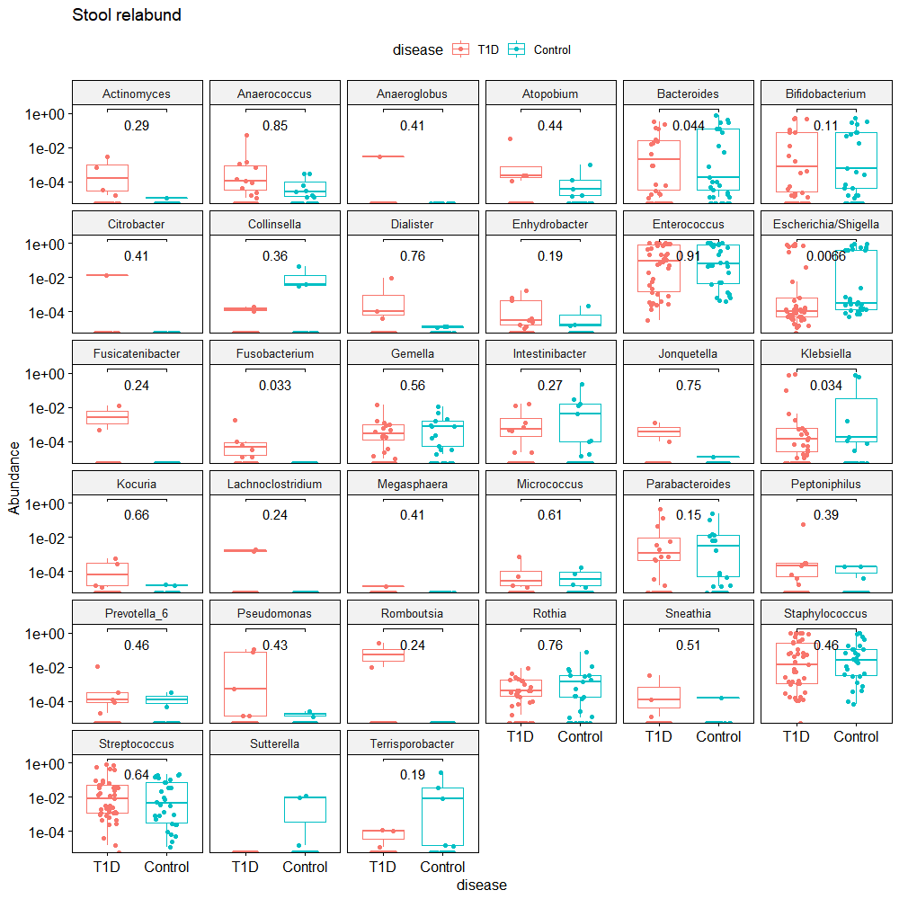
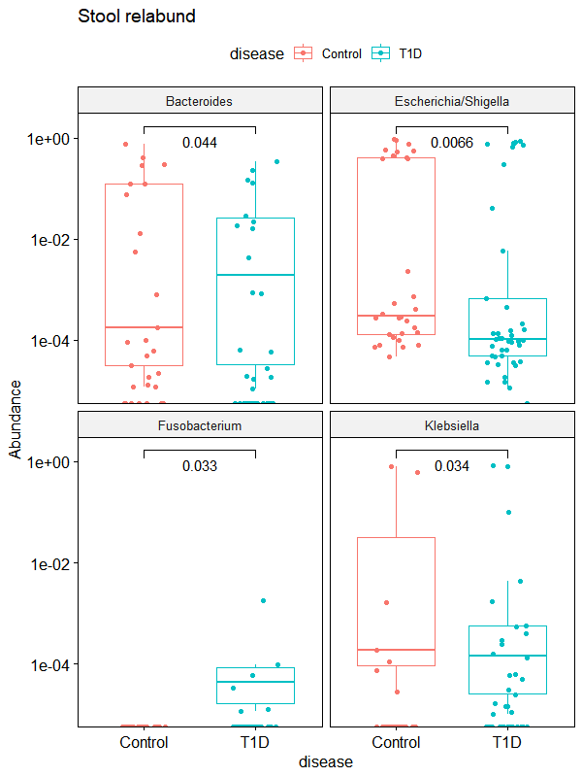

Slide 26
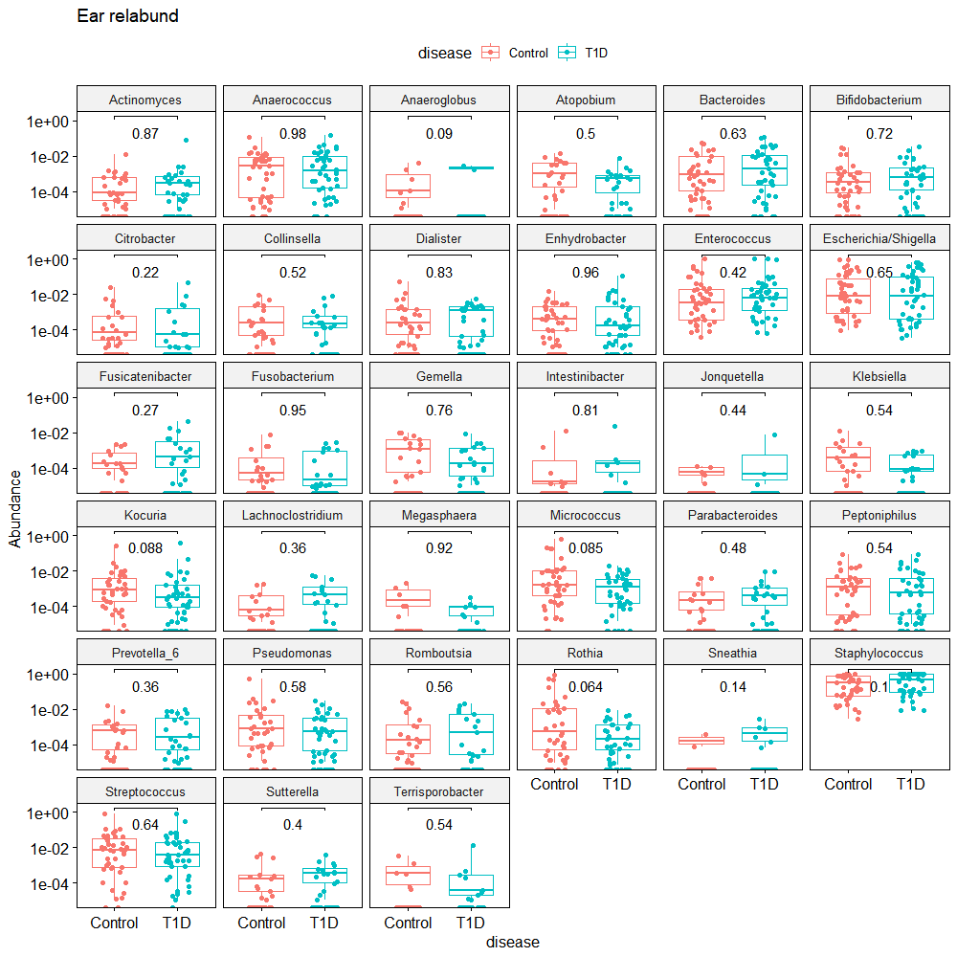
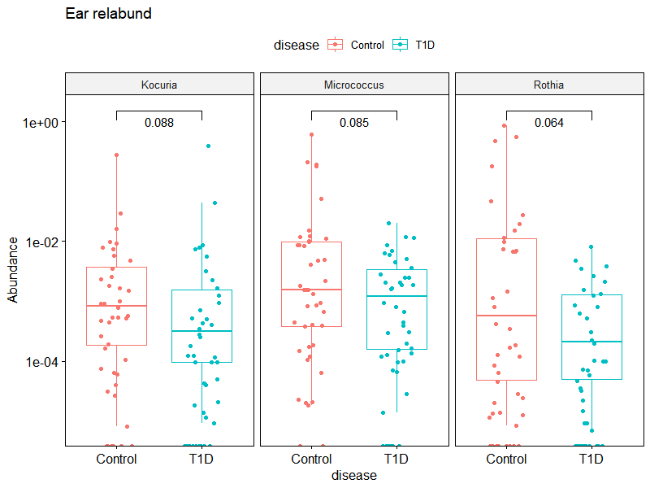

Slide 27
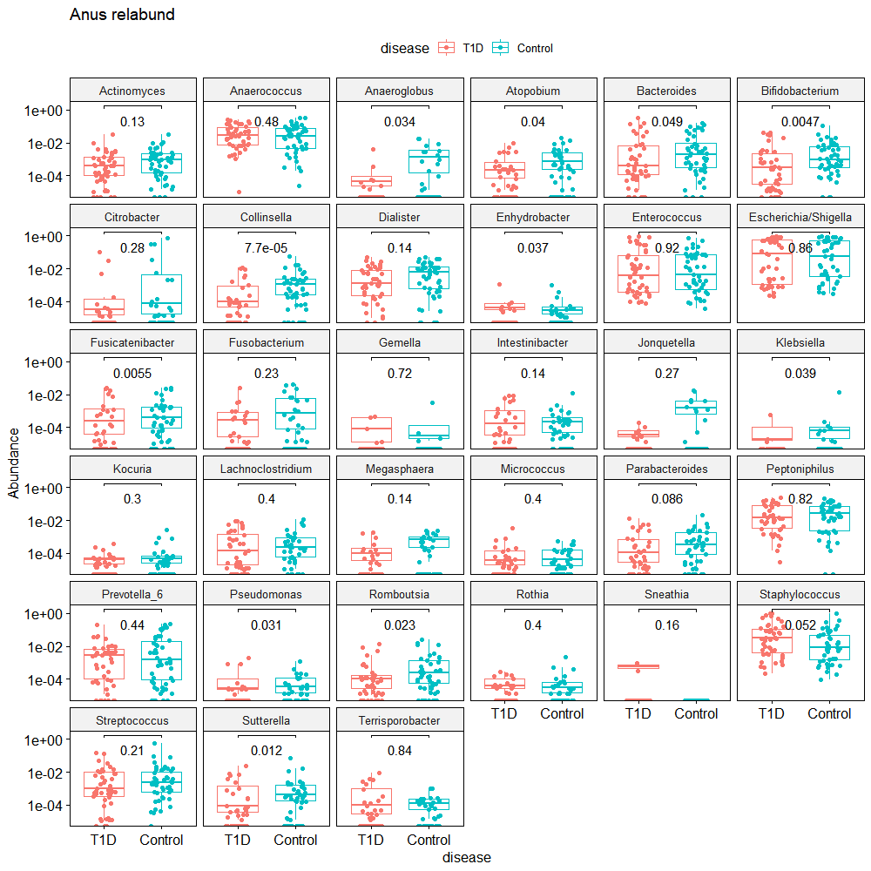
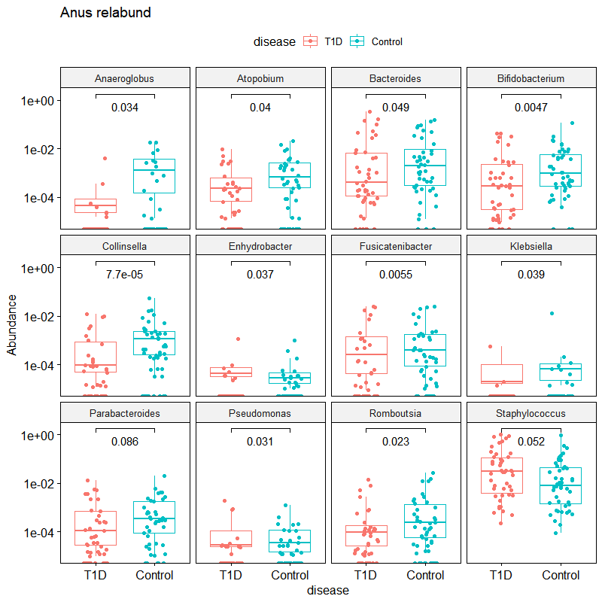

Slide 28
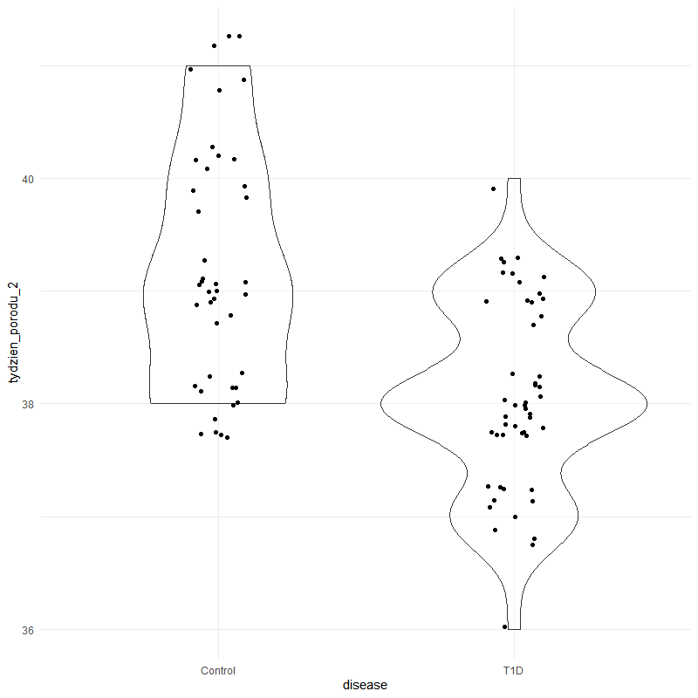
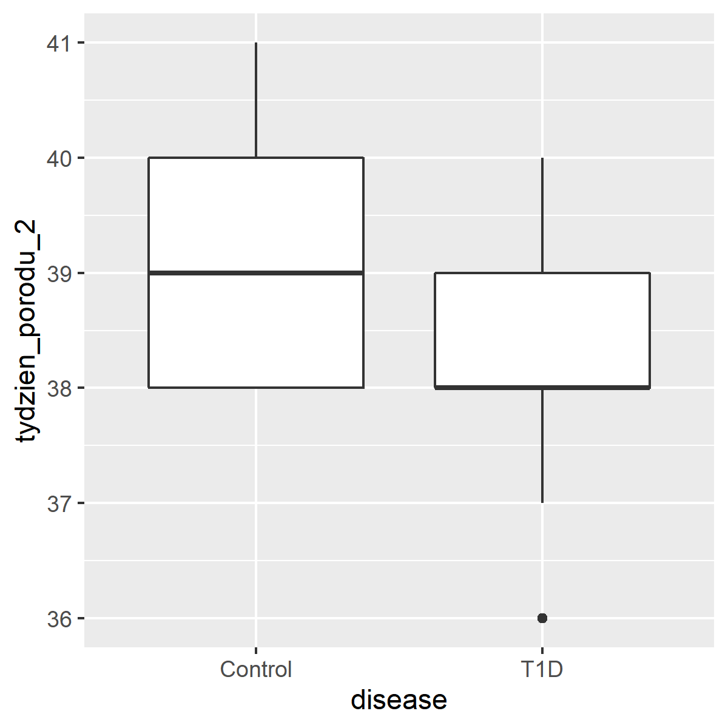
Continuous Variables_disease state and week of delivery
DELIVERY WEEK
*one newborn: week 36+6
Figure X. Violin plot comparison between disease state and week of delivery [p < 0.0001]
*one newborn 36+6

Slide 29
Table X. Log 2-fold change and p value of differentially expressed genera associated with Type 1 Diabetes
 | Cervix |  |  | Vagina |  |  | Introitus |  |  | Stool |  |  | Ear |  |  | Anus
Genus | lfc | p adj |  | lfc | p adj |  | lfc | p adj |  | lfc | p adj |  | lfc | p adj |  | lfc | p adj
Actinomyces | 0.18 | 1.00 |  | 1.67 | 0.34 |  | 0.71 | 1.00 |  | 2.88 | 0.01 |  | 0.82 | 0.96 |  | -0.47 | 1.00
Anaerococcus | -3.20 | 0.00 |  | -2.13 | 0.01 |  | -1.99 | 0.03 |  | 1.28 | 0.41 |  | 1.64 | 0.16 |  | 0.33 | 1.00
Anaeroglobus | -3.21 | 0.56 |  | 0.62 | 1.00 |  | -0.20 | 1.00 |  | 19.46 | 0.00 |  | -1.97 | 1.00 |  | -3.69 | 0.50
Atopobium | 6.62 | 0.00 |  | 6.82 | 0.00 |  | 2.88 | 0.08 |  | -0.11 | 1.00 |  | -1.89 | 0.54 |  | -2.04 | 0.45
Bacteroides | 6.34 | 0.00 |  | 2.14 | 0.19 |  | 1.26 | 1.00 |  | -3.03 | 0.01 |  | 1.58 | 0.42 |  | -0.09 | 1.00
Bifidobacterium | -5.86 | 0.00 |  | -0.29 | 1.00 |  | -3.03 | 0.04 |  | -0.01 | 1.00 |  | 0.96 | 1.00 |  | -1.74 | 0.55
Citrobacter | 2.57 | 0.51 |  | -0.10 | 1.00 |  | 15.31 | 0.00 |  | 1.25 | 1.00 |  | -0.65 | 1.00 |  | -4.74 | 0.04
Collinsella | -15.19 | 0.00 |  | -0.80 | 1.00 |  | -0.71 | 1.00 |  | -8.77 | 0.00 |  | 0.22 | 1.00 |  | -1.67 | 0.55
Dialister | -1.34 | 0.51 |  | -1.37 | 0.90 |  | -2.02 | 0.13 |  | 3.50 | 0.00 |  | -1.45 | 0.53 |  | -0.69 | 1.00
Enhydrobacter | 18.47 | 0.00 |  | -0.02 | 1.00 |  | -5.11 | 0.00 |  | 0.99 | 1.00 |  | 0.81 | 1.00 |  | -1.76 | 0.45
Enterococcus | -2.77 | 0.00 |  | 0.60 | 1.00 |  | 0.53 | 1.00 |  | 0.38 | 1.00 |  | 1.13 | 0.67 |  | 1.51 | 0.44
Escherichia/Shigella | 2.79 | 0.00 |  | -0.95 | 1.00 |  | -1.13 | 1.00 |  | -0.51 | 1.00 |  | -3.05 | 0.00 |  | 0.85 | 0.92
Fusicatenibacter | 14.24 | 0.00 |  | -0.02 | 1.00 |  | 1.62 | 1.00 |  | 26.44 | 0.00 |  | 3.29 | 0.07 |  | -1.18 | 0.94
Fusobacterium | -3.91 | 0.01 |  | -1.70 | 1.00 |  | -0.89 | 1.00 |  | 20.09 | 0.00 |  | -0.49 | 1.00 |  | -1.69 | 0.70
Gemella | 7.91 | 0.00 |  | 7.03 | 0.00 |  | 21.38 | 0.00 |  | -1.56 | 1.00 |  | -1.51 | 1.00 |  | -1.26 | 1.00
Intestinibacter | 17.92 | 0.00 |  | 14.82 | 0.00 |  | -1.35 | 1.00 |  | -2.97 | 0.22 |  | -1.29 | 1.00 |  | 0.00 | 1.00
Jonquetella | 15.35 | 0.00 |  | -1.29 | 1.00 |  | 5.47 | 0.12 |  | 2.97 | 0.93 |  | 0.21 | 1.00 |  | -6.37 | 0.05
Klebsiella | 2.10 | 0.67 |  | -2.07 | 1.00 |  | 7.79 | 0.00 |  | 1.50 | 1.00 |  | 0.06 | 1.00 |  | -5.03 | 0.02
Kocuria | 1.09 | 1.00 |  | -1.14 | 1.00 |  | -1.80 | 0.45 |  | 0.83 | 1.00 |  | -3.29 | 0.00 |  | -0.39 | 1.00
Lachnoclostridium | 0.00 | 1.00 |  | -0.53 | 1.00 |  | 0.10 | 1.00 |  | 3.84 | 0.01 |  | 1.57 | 0.67 |  | 0.12 | 1.00
Megasphaera | 4.17 | 0.02 |  | 7.80 | 0.00 |  | 3.28 | 0.27 |  | 15.61 | 0.00 |  | -1.60 | 1.00 |  | -2.02 | 0.72
Micrococcus | -0.58 | 1.00 |  | -2.24 | 0.11 |  | -0.32 | 1.00 |  | -0.98 | 1.00 |  | -3.71 | 0.00 |  | 0.78 | 1.00
Parabacteroides | 16.91 | 0.00 |  | 0.37 | 1.00 |  | 0.66 | 1.00 |  | -1.02 | 1.00 |  | 1.05 | 0.99 |  | -1.23 | 0.79
Peptoniphilus | -0.08 | 1.00 |  | 0.60 | 1.00 |  | 0.45 | 1.00 |  | 3.42 | 0.00 |  | 1.41 | 0.24 |  | 0.03 | 1.00
Prevotella_6 | 0.28 | 1.00 |  | 3.78 | 0.00 |  | 2.52 | 0.12 |  | 0.89 | 1.00 |  | -0.28 | 1.00 |  | -1.09 | 0.90
Pseudomonas | 1.24 | 0.66 |  | 1.05 | 1.00 |  | 0.03 | 1.00 |  | 7.51 | 0.00 |  | -0.95 | 0.90 |  | -0.54 | 1.00
Romboutsia | 0.00 | 1.00 |  | -0.43 | 1.00 |  | 0.05 | 1.00 |  | 6.40 | 0.00 |  | -0.03 | 1.00 |  | -1.86 | 0.55
Rothia | -0.67 | 1.00 |  | 2.01 | 0.65 |  | 1.07 | 1.00 |  | -0.78 | 1.00 |  | -7.75 | 0.00 |  | 0.18 | 1.00
Sneathia | 42.95 | 0.00 |  | 49.75 | 0.00 |  | 6.19 | 0.49 |  | -0.63 | 1.00 |  | 4.16 | 0.88 |  | 13.86 | 0.00
Staphylococcus | -2.09 | 0.00 |  | 0.35 | 1.00 |  | 2.43 | 0.00 |  | 0.96 | 0.71 |  | 0.58 | 1.00 |  | 3.13 | 0.00
Streptococcus | 0.07 | 1.00 |  | -3.58 | 0.00 |  | 1.82 | 0.16 |  | 0.21 | 1.00 |  | 0.57 | 1.00 |  | -1.42 | 0.48
Sutterella | -0.68 | 1.00 |  | -0.68 | 1.00 |  | -0.07 | 1.00 |  | -5.19 | 0.00 |  | 0.22 | 1.00 |  | -1.69 | 0.60
Terrisporobacter | 14.20 | 0.00 |  | 0.00 | 1.00 |  | 14.70 | 0.00 |  | -7.66 | 0.00 |  | 1.01 | 1.00 |  | 0.59 | 1.00

Slide 30
D) Anus
Figure X. Wilcox test comparisons of differentially expressed genera associated with Type 1 Diabetes in the A) Vaginal canal, B) Cervix, C) Vaginal Introitus, and D) Anus samples

Slide 31
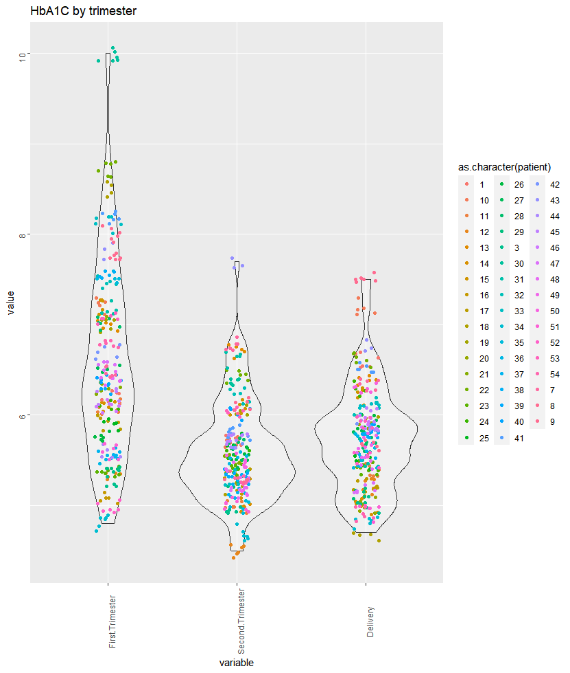
GLYCAEMIC CONTROL
during first, second and third (before delivery) pregnancy trimesters in T1D mothers
Here, differences between first and second trimesters, and first and third trimesters were statistically significant;
Glycaemic control was satisfactory in second and third trimesters
Tukey multiple comparisons of means (95% family-wise confidence level)
Variable diff lwr upr p adj
Second.Trimester-First.Trimester -0.9965909 -1.15613634 -0.8370455 0.0000000
Delivery-First.Trimester -0.8482995 -1.00527833 -0.6913206 0.0000000
Delivery-Second.Trimester 0.1482914 -0.00868742 0.3052703 0.0687493
Notes:
July30, 2020, Figure – modify, remove duplicates

Slide 32
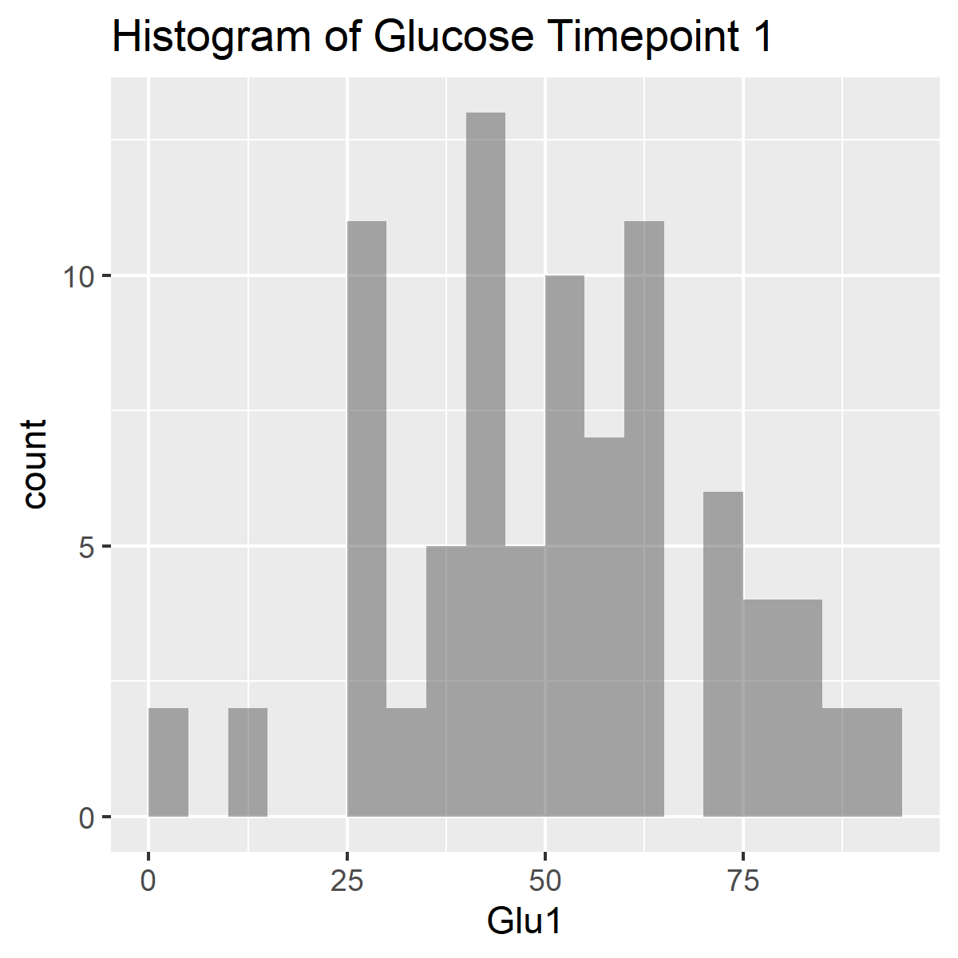
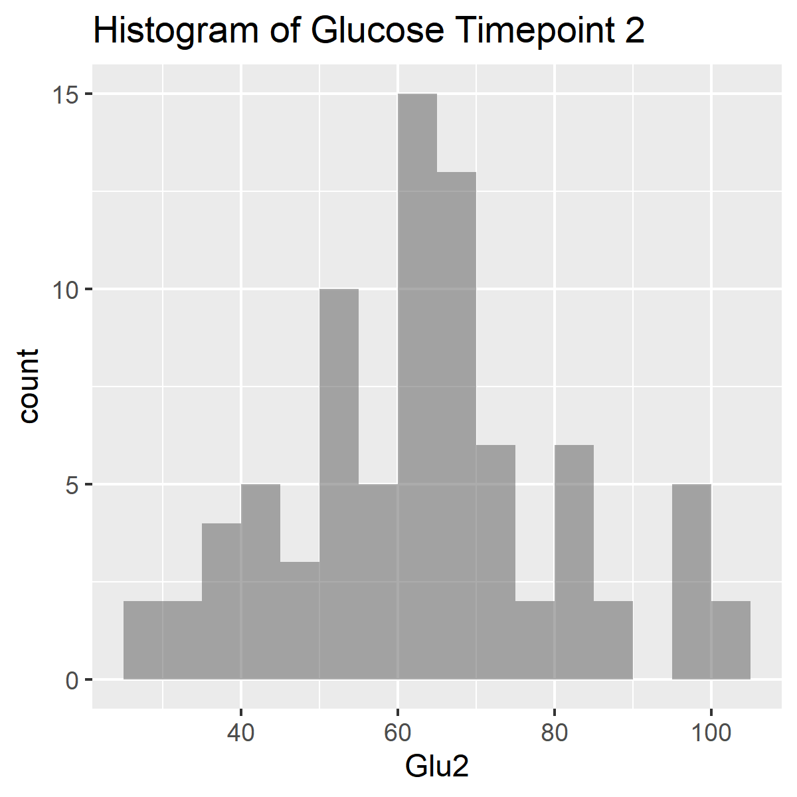
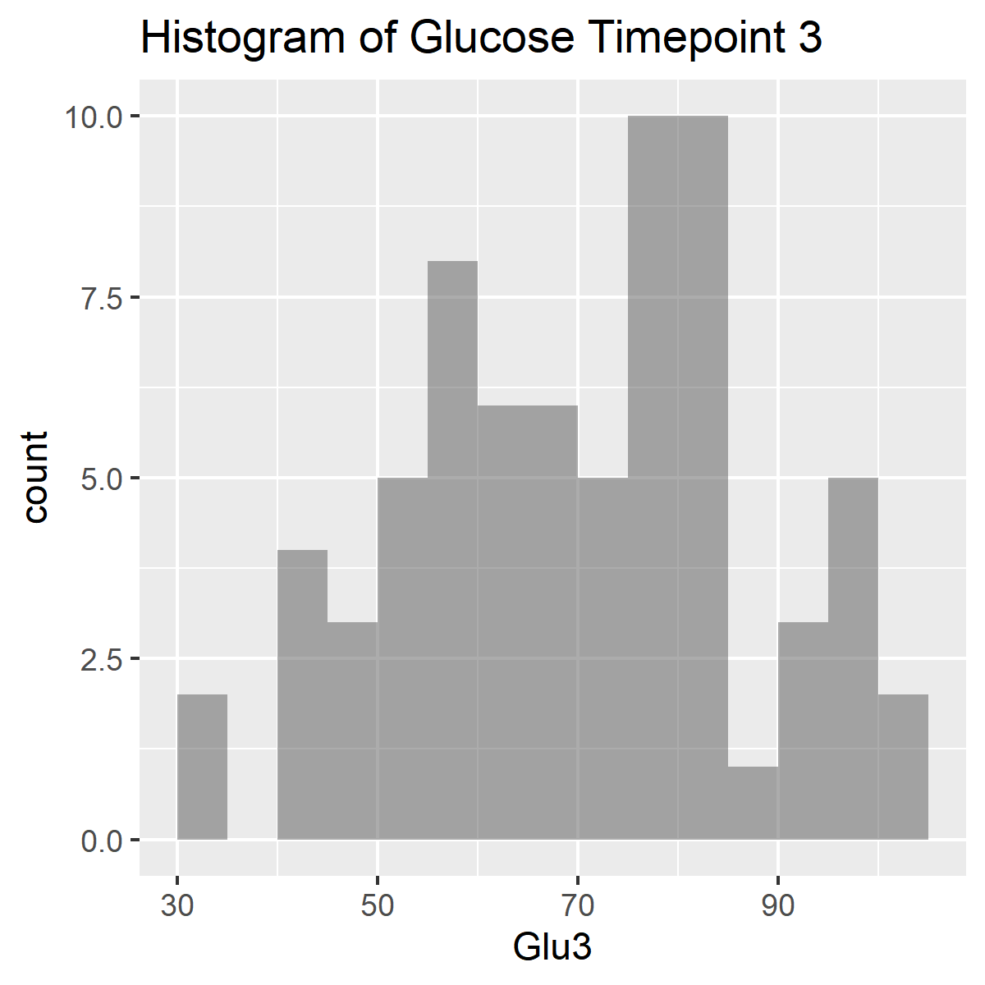
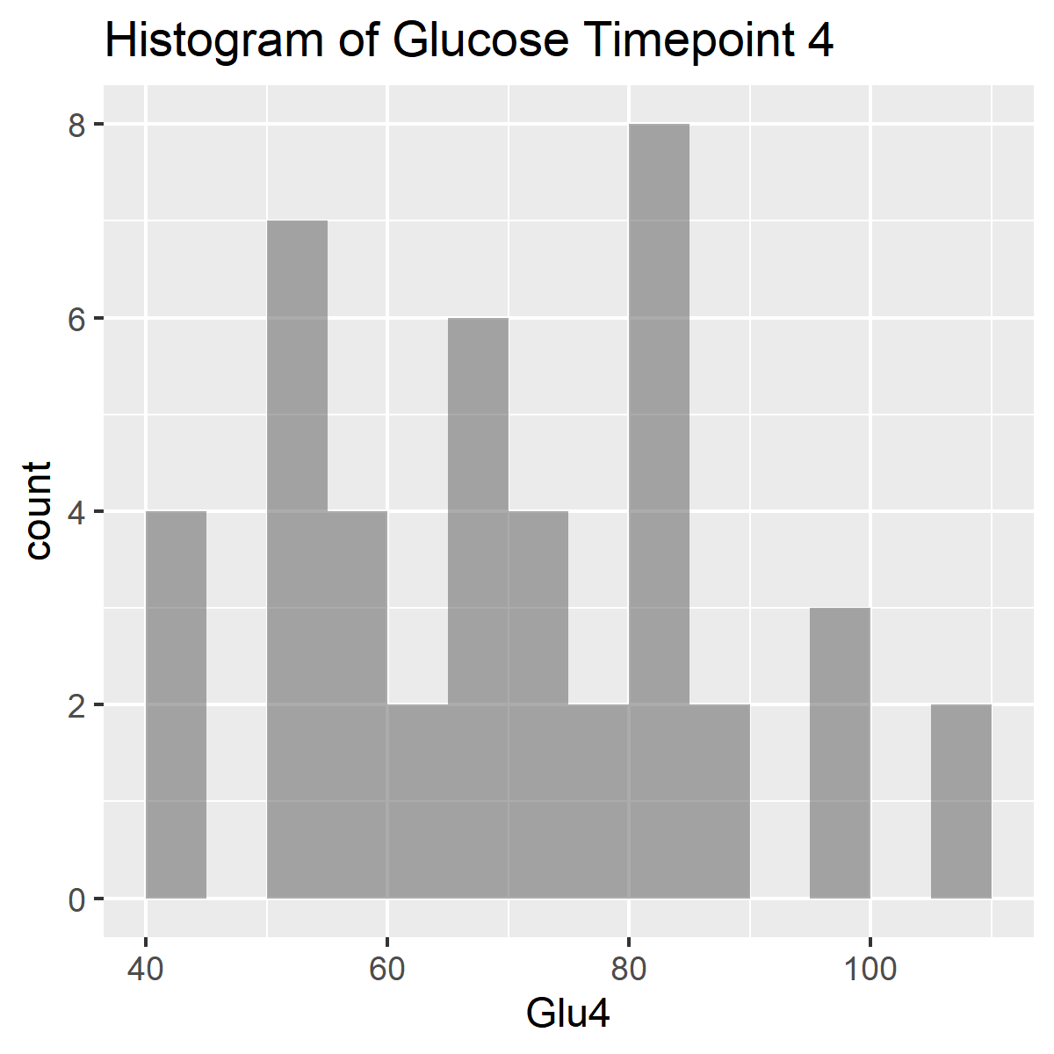
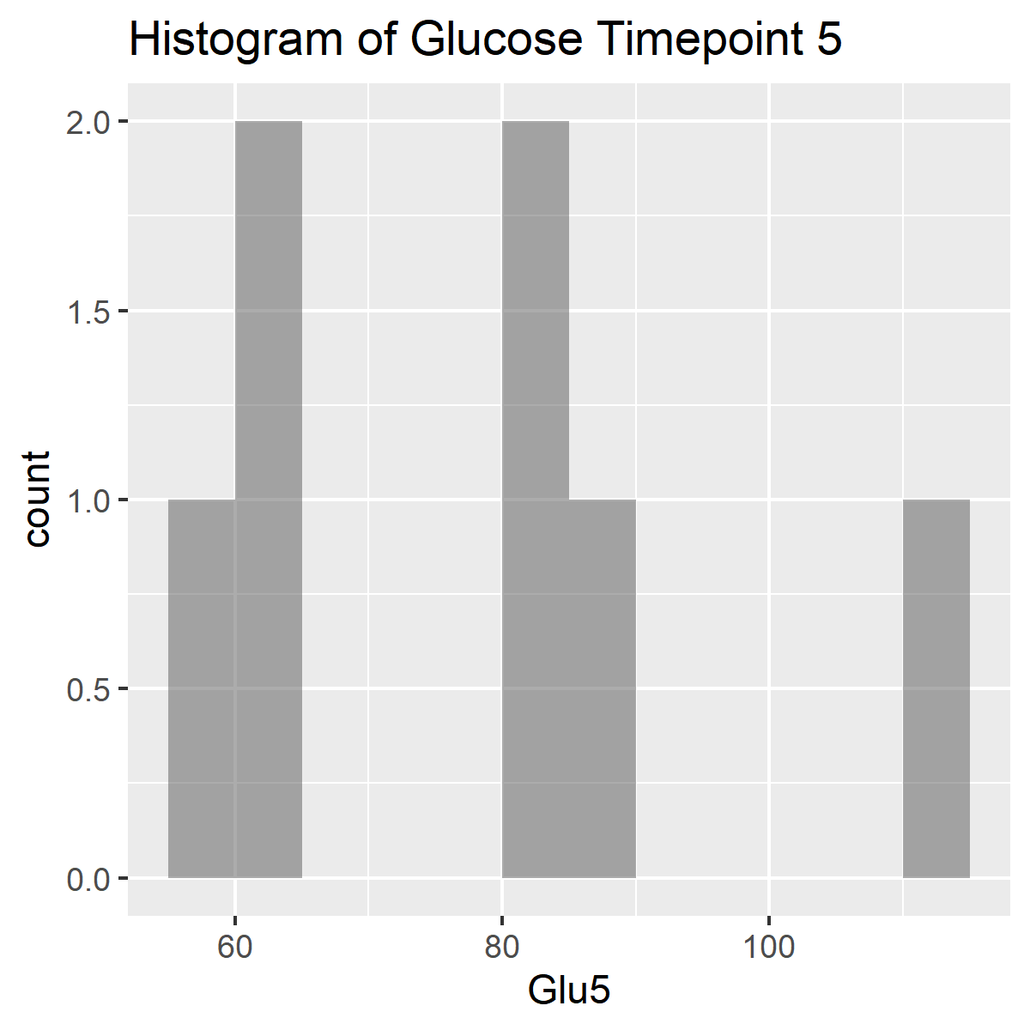
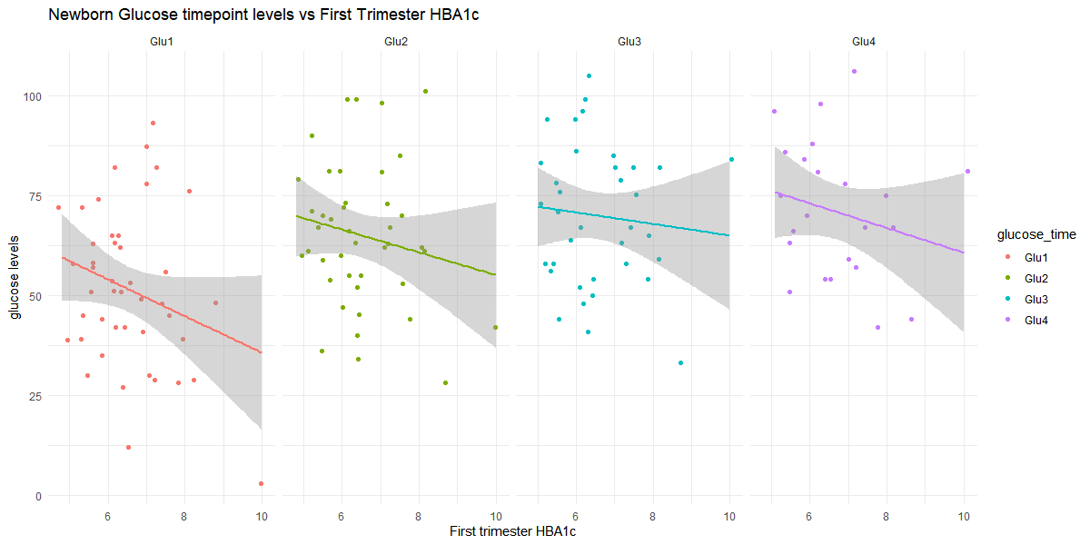
Notes:
30 July 2020

Slide 33
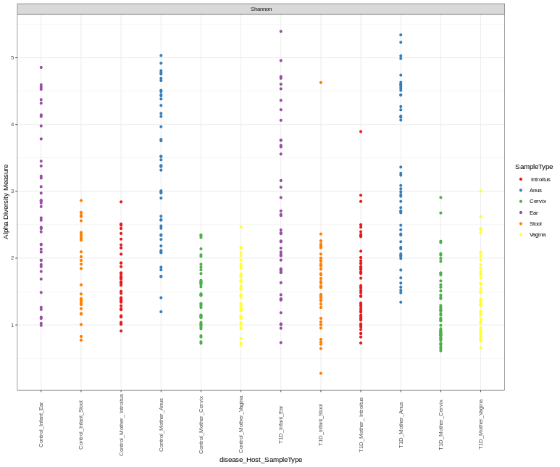
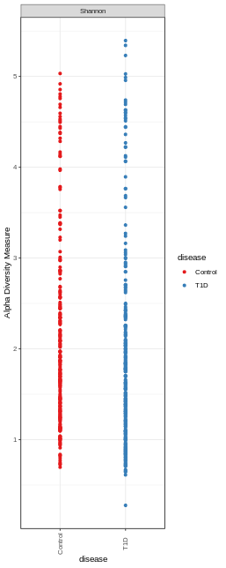
Alpha diversity estimates (Shannon)
Control T1D
Infant Mother Infant Mother
Ear
Stool
Introitus
Anus
Cervix
Vagina
Ear
Stool
Introitus
Anus
Cervix
Vagina
Notes:
OK: Alpha Diversity Estimates: Shannon only
X disease; color disease, shape null, size 10, opacity 1, max. Labels 30. angle 90; source data original, width 4, height 10
Disease_Host_Sample Type/Color: SampleType/null

Slide 34
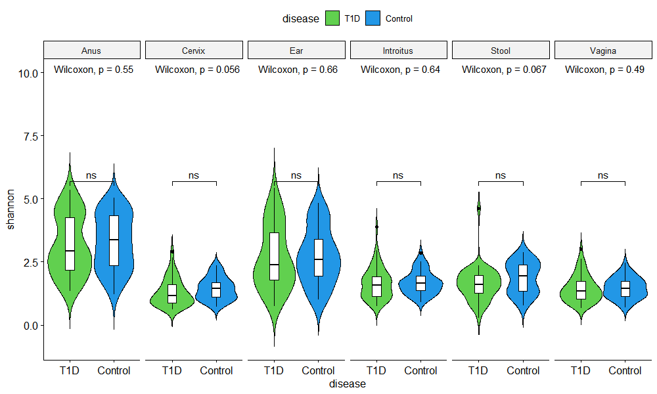
Alpha diversity estimates (Shannon)
library(microbiome)
library(ggpubr)
sam<-data.frame(sample_data(ASV_physeq_core))
alpha<-alpha(x = ASV_physeq_core,index = "shannon")
sam$shannon<-alpha$diversity_shannon
ggviolin(sam, x = "disease", y = "shannon", fill = "disease",
palette =c("#61D04F","#2297E6"),theme_bw()+
add = "boxplot", add.params = list(fill = "white"))+
stat_compare_means(comparisons = my_comparisons, label = "p.signif")+ # Add significance levels
stat_compare_means(label.y = 10) +facet_grid(facets = ~SampleType) # Add global the p-value
Notes:
OK: Alpha Diversity Estimates: Shannon only
X disease; color disease, shape null, size 10, opacity 1, max. Labels 30. angle 90; source data original, width 4, height 10
Disease_Host_Sample Type/Color: SampleType/null

Slide 35
Continuous Variables_Delivery week (37-41, no preterm babies)
Mother's Clinical Characteristics
 | T1D group (n=50) | Control group (n=42)
Gestation (weeks), mean ± SD | 38,1 ± 0,7 | 39,2 ± 1,0
37 38 39 40 41

Slide 36
Here are a couple optional balloon plots that I created as optional replacements for the existing taxa plots

Slide 37
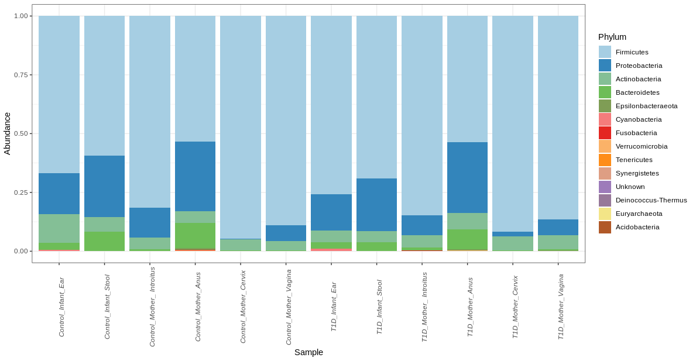
Microbiota relative abundance, Newborns and Mothers, separately
Control
T1D
Notes:
Just to remind

Slide 38
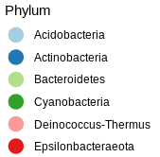


Microbiota composition_Phylum level_NMDS
Notes:
Just to remind

Slide 39

Mikrobiota abundance (Phylum level) in materials tested_separately
Control_introitus
Control_cervix
Control_annus
Control_ear
Control_stool
Control_vagina
T1D _introitus
T1D _cervix
T1D _annus
T1D _ear
T1D _stool
T1D_vagina
Notes:
Just to remind

Slide 40

Microbiota relative abundance, Newborns and Mothers, separately
Mean relative abundance
Notes:
Just to remind

